Slide 1
OT Timeline Week 3
Egypt through the Judges

Slide 2
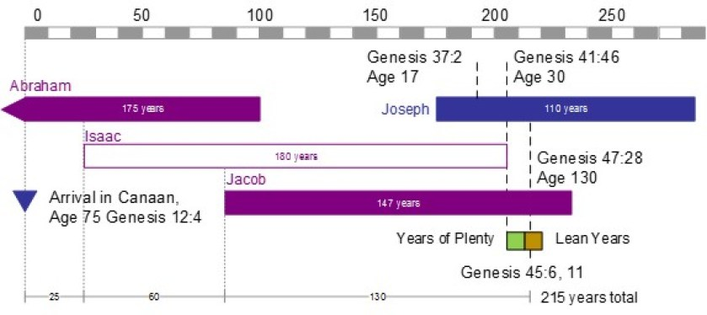
Approximate Years BC
1975 1925 1875 1825 1775 1725
“…all the souls of the house of Jacob, which came into Egypt were threescore and ten” – Gen 46:27

Slide 3
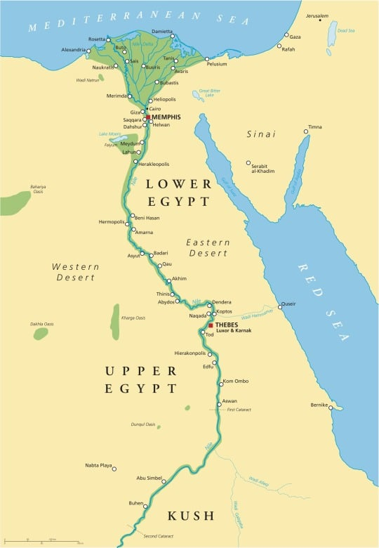
Egyptian Dynasties in Late Genesis and Early Exodus
Second Intermediate Period (1802 – 1550 BC)
A period of disarray
14th, 15th dynasties (1710 – 1535 BC)
Known as the Hyksos dynasties
Semetic names – Yakbim – founder of 14th dynasty
Ruled in Lower Egypt
Generally ruled from Avaris (later known as Ramses)
16th Dynasty (1650-1580)
Ruled in Memphis
Conquered by Hyksos
17th Dynasty (1650 – 1550 BC)
Ruled Upper Egypt from Thebes
New Kingdom (1550-1077 BC)
18th, 19th, 20th dynasties
Marked by unification of Egypt and military expansion
Amenhotep I conquered Lower Egypt
Likely Pharaoh “which knew not Joseph” – Ex 1:8
Likely placed Hebrews (along with Hyksos and their supporters) into slavery

Slide 4
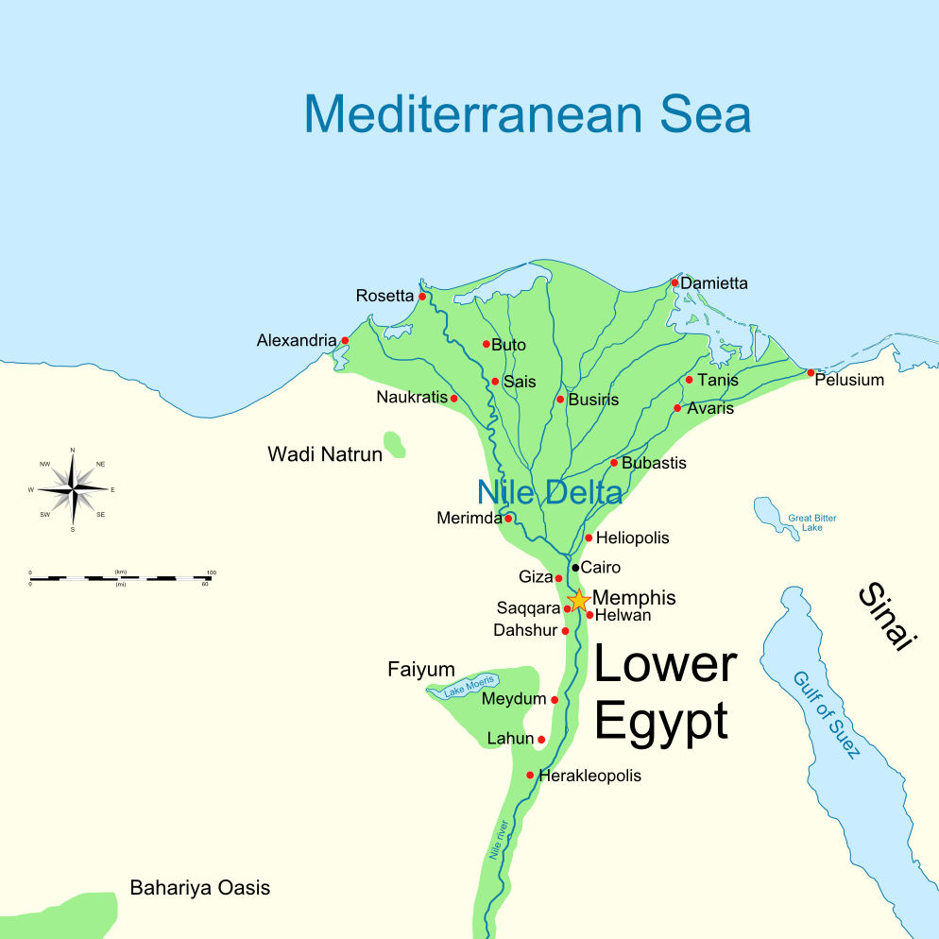
The land of Goshen – Gen 47:6

Slide 5
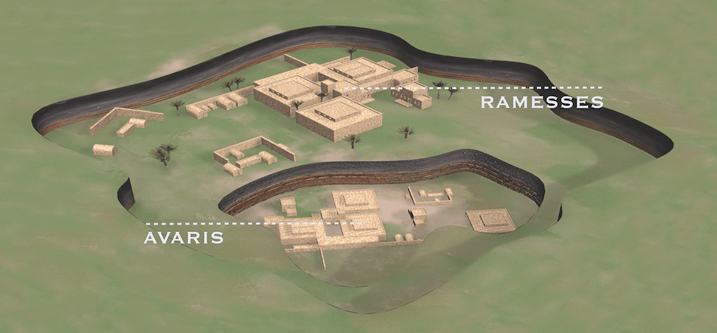

Slide 6
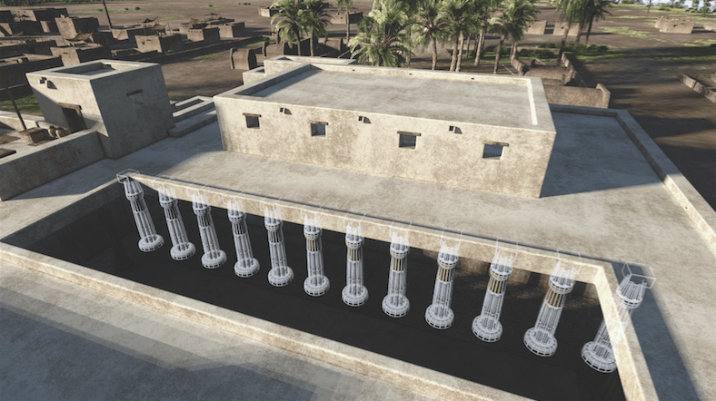
The Palace at Avaris

Slide 7
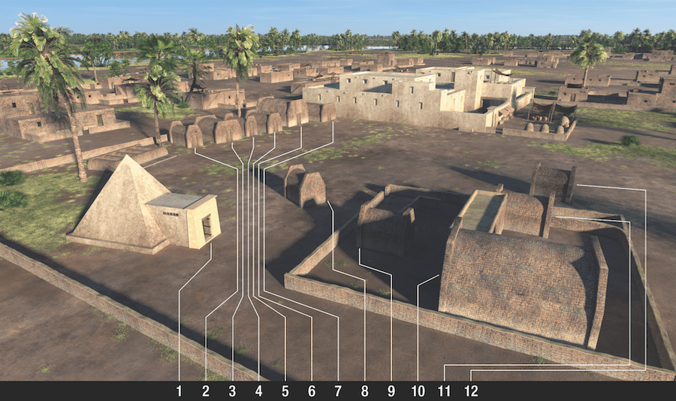
Tombs Behind Palace at Avaris
Remains found in all tombs except the one with a pyramid – Ex 13:19

Slide 8
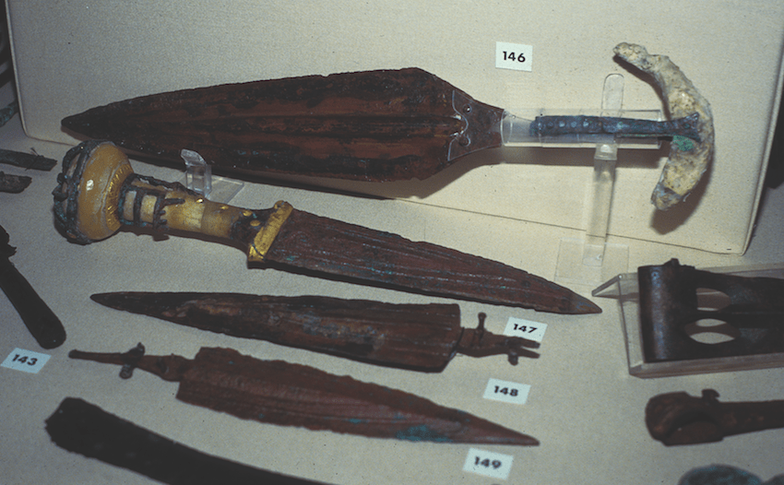
Weapons found in only 2 of the 12 tombs
Gen 49:5 – “instruments of Cruelty” – likely tombs of Simeon and Levi

Slide 9
Statue inside tomb with Pyramid
“Mushroom” style hair style is common for western Asiatic foreigners in contemporary Egyptian art
Image to right is enhanced to emphasize the pattern of the paint fragments

Slide 10
Coming out of Egypt
Num 1 gives an account of the census of the Israelites
Taken “first day of the second month in the second year after they were come out of the land of Egypt”
Army numbered 603,530 - Num 1:46
Just the men
Did not include Levites – Num 1:47
Likely population around 2 million
Estimates for the total population of Egypt at the time are around 4 million

Slide 11
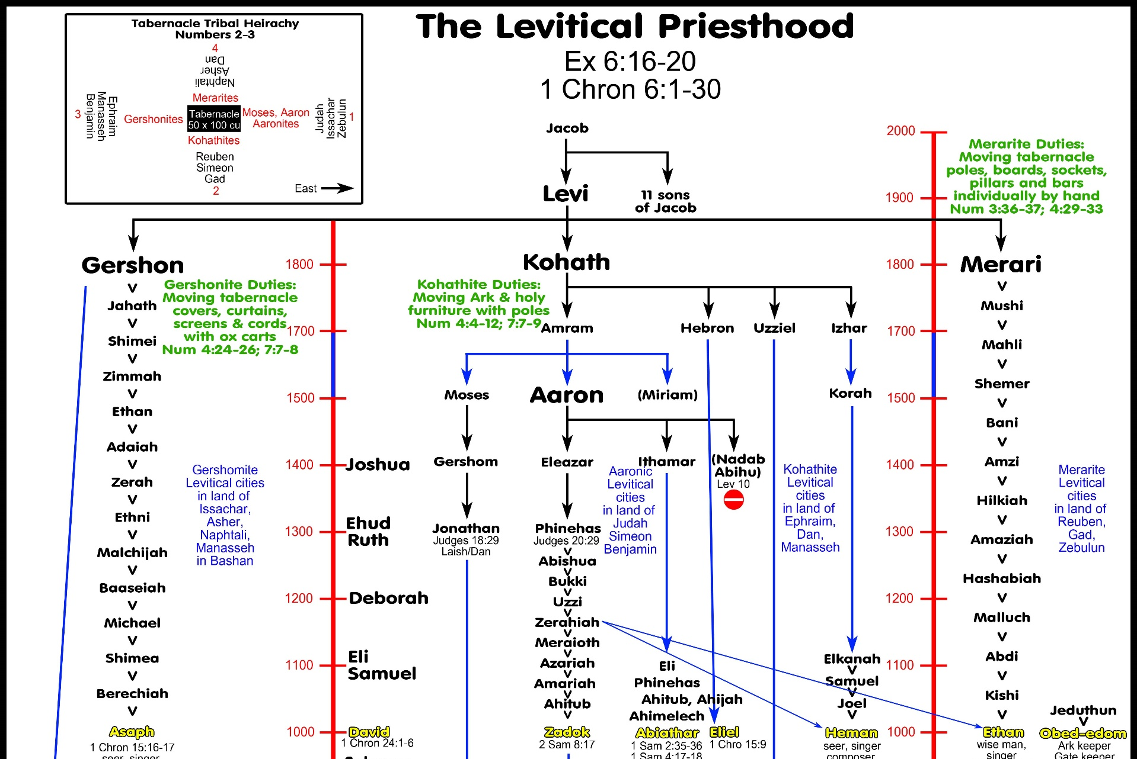
NOTE: These dates are out of sync with previous slides and use different assumptions about various fixed points in time

Slide 12
End of a Dispensation
Promise – began after Babel
Test – Believe God will keep his Promise – Gen 12:1-3
This is NOT the same as the Abrahamic Covenant
The Covenant (Gen 15) has no end – it is an agreement with the Jews and is in effect so long as there are Jews
The Dispensation of Promise was a test
Ultimate Failure – “All that the Lord hath spoken we will do” – Ex 19:8
Ultimate Judgement – Do the Law

Slide 13
New Dispensation
Law – began on Mt Sinai
Test – keep the WHOLE law – James 2:10
Ultimate Failure – “Crucify Him” – Mark 15:13
Ultimate Judgement – Christ crucified

Slide 14
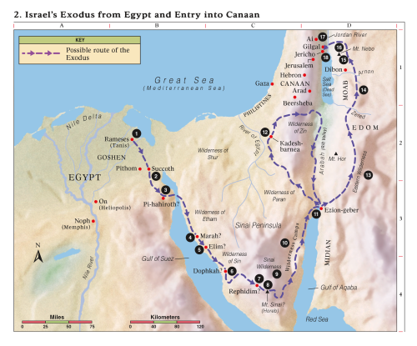
Rameses Israel was thrust out of Egypt (Ex. 12; Num. 33:5).
Succoth After the Hebrews left this first campsite, the Lord attended them in a cloud by day and in a pillar of fire by night (Ex. 13:20–22).
Pi-hahiroth Israel passed through the Red Sea (Ex. 14; Num. 33:8).
Marah The Lord healed the waters of Marah (Ex. 15:23–26).
Elim Israel camped by 12 springs (Ex. 15:27).
Wilderness of Sin The Lord sent manna and quail to feed Israel (Ex. 16).
Rephidim Israel fought with Amalek (Ex. 17:8–16).
Mount Sinai (Mount Horeb or Jebel Musa) The Lord revealed the Ten Commandments (Ex. 19–20).
Sinai Wilderness Israel constructed the tabernacle (Ex. 25–30).
Wilderness Camps Seventy elders were called to help Moses govern the people (Num. 11:16–17).

Slide 15
Ezion-geber Israel passed through the lands of Esau and Ammon in peace (Deut. 2).
Kadesh-barnea Moses sent spies into the promised land; Israel rebelled and failed to enter the land; Kadesh served as the main camp of Israel for many years (Num. 13:1–3, 17–33; 14; 32:8; Deut. 2:14).
Eastern Wilderness Israel avoided conflict with Edom and Moab (Num. 20:14–21; 22–24).
Arnon River Israel destroyed the Amorites who fought against them (Deut. 2:24–37).
Mount Nebo Moses viewed the promised land (Deut. 34:1–4). Moses delivered his last three sermons (Deut. 1–32).
Plains of Moab The Lord told Israel to divide the land and dispossess the inhabitants (Num. 33:50–56).
Jordan River Israel crossed the Jordan River on dry ground. Near Gilgal, stones from the bottom of the Jordan River were placed as a monument of Jordan’s waters being divided (Josh. 3:1–5:1).
Jericho The children of Israel captured and destroyed the city (Josh. 6).

Slide 16
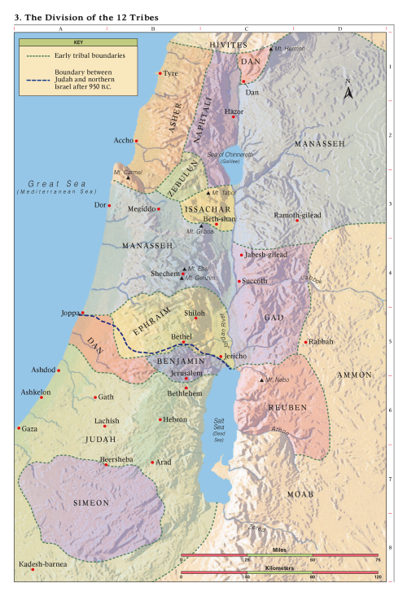

Slide 17
Outline: Book of Judges
Chapter(s) Theme(s)
1 Political Background
2-3:6 Spiritual Background
i. abandon God
ii. follow idols
iii. Sold as Slaves
iv. Lord sends a Deliver
3:7-16 Oppression and Deliverance
i. Judges – Chronological Order
17-21 Abandon their belief in God
(aka Apostasy)

Slide 18
Serve
the Lord
Rest
Trust anyone
but God
Lord raises up Deliverer
Cycle of
Idolatry
Idols
Provoke God to anger
Cry to the Lord
Yoke of Slavery

Slide 19
Biblical Roadmap Joshua, Judges, and Ruth
Red Sea
1446 BC
Gilgal & Jericho
1406 BC
Joshua
2
Lived 110 yrs.
1204
1302
3.2
Judges
Orthniel
Ehud
Moses
~350 yrs.
18 op+80 yrs
Gen-Deut.
3.1
8 op+40 yrs
1
Lived 120 yrs.
3.0
1284
1
2
3.1
3.2
40 yrs.
1400
1350
1300
Mesopotamia
Moab
Wilderness
Wandering 40 yrs
Ruth & Boaz

Slide 20
Gideon
Samson 20 yrs
7 op+40 yrs
3.0
Midian
Philistia
1050
United Kingdom
1302
1191
1144
120 yrs.
4.0
1010
970
930
Ehud
1204
48 yrs.
98 yrs
47 yrs.
4.1
4.2
4.3
3
1350
1300
1250
1200
1150
1100
1050
1000
950
900
Eli
Samuel
80 yrs
Divided
Kingdom
40 yrs
5
Judges
350-410 years
120 yrs
1134
1094
1014

Slide 21
Shamgar
1191
3.5
Abimelech & Jephthah
Gideon
3.6
3.3
3.4
9 yrs
Midian
Philistia
1050
1144
United Kingdom
4
120 yrs.
Ehud
48 yrs.
98 yrs.
47 yrs.
Samson
20 yrs
Orthniel
3.7
1350
1300
1250
1200
1150
1100
1050
1000
950
900
Deborah
40 yrs
Eli
Samuel
80 yrs
40 yrs
120 yrs
Judges
Chapters 3-16
Canaan
1134
1094
1014

Slide 22
Path of the Righteous
Bear Fruit
Prepare:
Delight in God’s Word
Rest
Repent
Serve the Lord
with Gladness

