Slide 1
OT Timeline - Week 8
Captivity to Christ
535 BC – 31 AD
Daniel
Ezra
Nehemiah
Esther

Slide 2
Agenda
Ezra, Nehemiah, and Esther
100% accurate prophecies of Daniel
Intertestamental Witness – God preparing for The Way

Slide 3
Reign of Nebuchadnezzar II
605 BC – 562 BC
605 BC – 1st invasion of Jerusalem – Start of captivity
Dan 3 - Shadrach, Meshach, Abednego and the Fiery Furnace
Exact year unknown
Dan 4 - Nebuchadnezzar's 2nd Dream and subsequent 7 years of Madness
Exact year unknown
562
560
Evil Merodach
Nergal-shar-usur
556
Nabonidas / Belshazzar
Dan 5 - Writing on the wall
Night of fall of Babylon
539
539 BC – Fall of Babylon
Dan 6 - Daniel and the lion’s den
Exact year unknown – during Darius
Darius the Mede
536
Cyrus the Great
535 BC – Decree to return to the land

Slide 4
Median – Persian Royal Families
Medes
Persians
Cyaxares I
Cyrus I
Astyages
Cyaxares II
Princess
Mandane
Cambyses I
“Darius the Mede”
Cyrus II
“the Great”

Slide 5
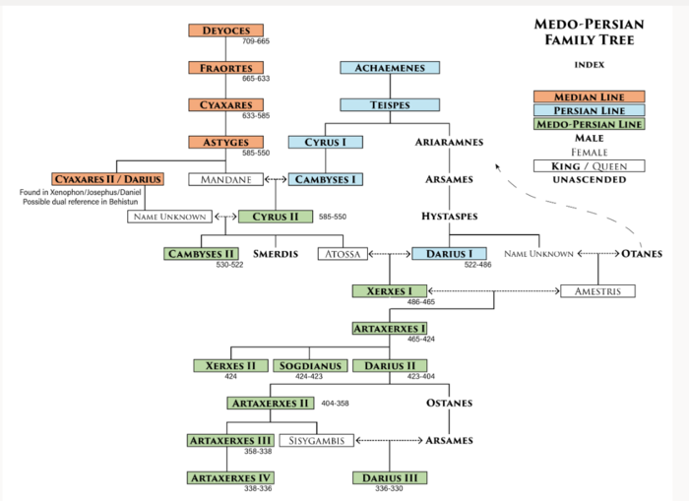
“Darius the Mede”
“Cyrus the Great”
“Mad King”
“Bardiya”

Slide 6
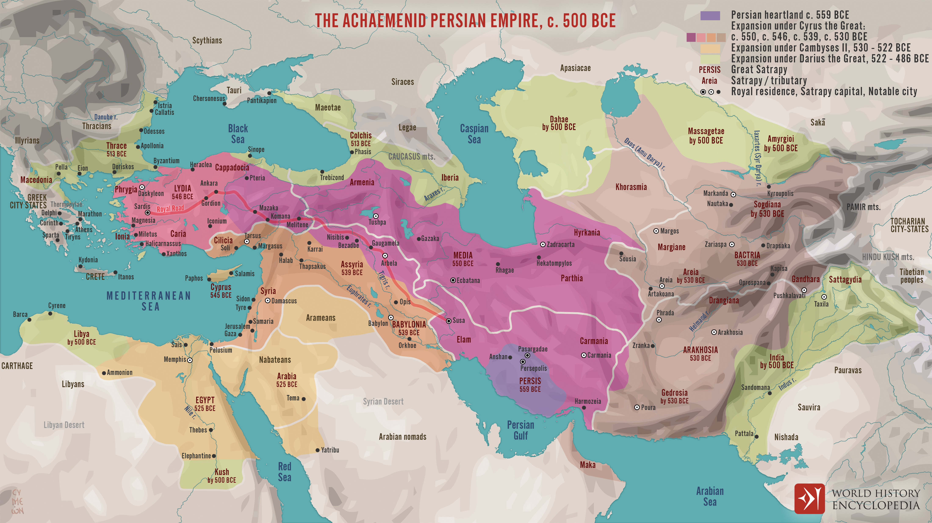

Slide 7
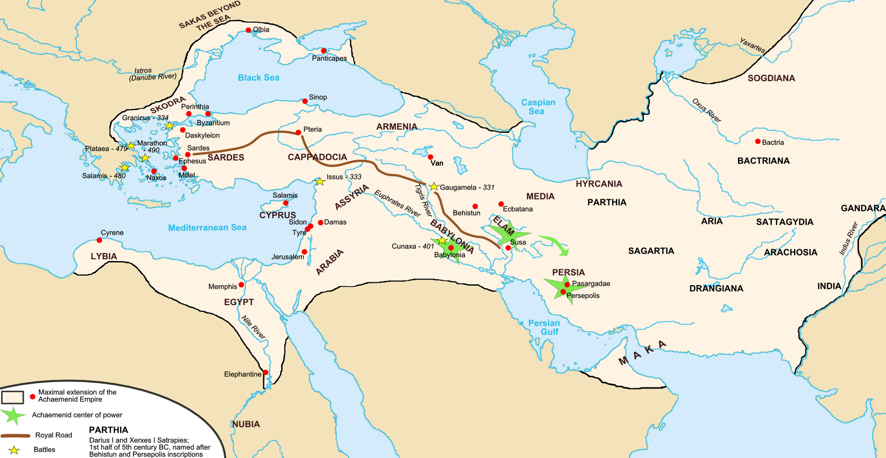

Slide 8
Cyrus II (“the Great”
585 BC – 530 BC
Rest of the World
Israel
Babylon Conquered – 539 BC (Belshazzar, Daniel, Writing on Wall)
Babylonian Captivity ended – 537 BC
Cyrus II sends Jews back to Jerusalem, led by Zerubbabel – 1st Return
Cambyses II
530 BC – 522 BC
Darius I (“the Great”
522 BC – 486 BC
Temple FINALLY begins building– 520 BC
Temple Finished – 515 BC
Battle of Marathon – 490 BC
Darius Defeated by Greeks
Battle of Thermopylae – 480 BC
Xerxes Defeated by Spartan 300
Xerxes I (King Ahasuerus)
486 BC – 465 BC
Esther? – 460 BC
Battle of Thermopylae – 479 BC
Xerxes Defeated by Greek Alliances
Artaxerxes I (Longimanus)
465 BC – 424 BC
Ezra – 457 BC
Leads 2nd Group of Exiles back to Jerusalem – 2nd Return
Nehemiah – 444 BC
Made the governor of Judah, builds the walls – 3rd Return
Xerxes II (424 BC)
Nehemiah returns to Shushan – 432 BC
Sogdianus (424 BC – 423 BC)
Darius II
423 BC – 404 BC

Slide 9
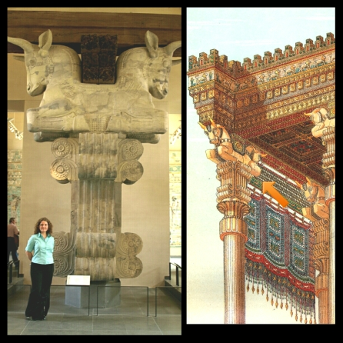
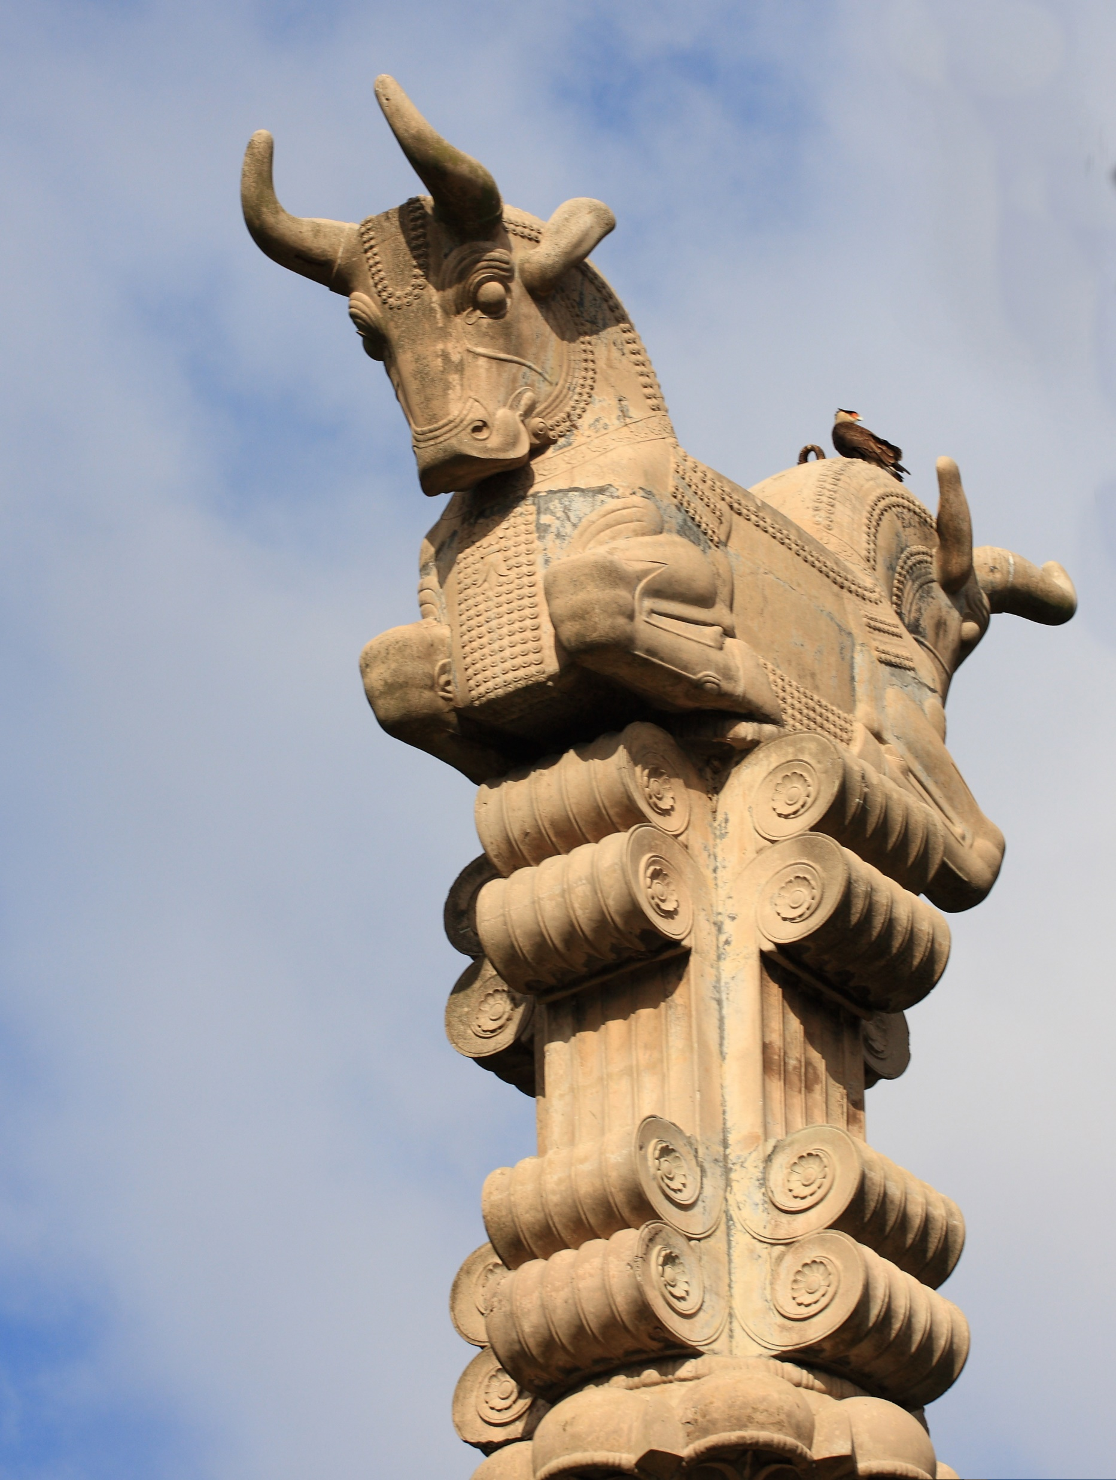

Slide 10
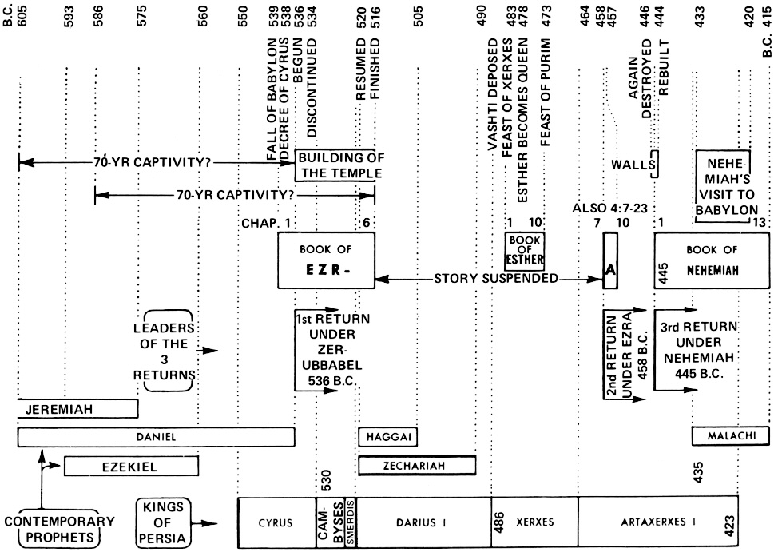

Slide 11
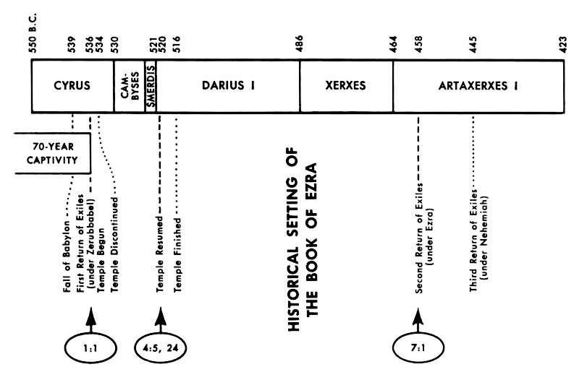

Slide 12
POSSIBILITY
(up for debate)

Slide 13
Reign of Nebuchadnezzar II
605 BC – 562 BC
605 BC – 1st invasion of Jerusalem – Start of captivity
Dan 3 - Shadrach, Meshach, Abednego and the Fiery Furnace
Exact year unknown
Dan 4 - Nebuchadnezzar's 2nd Dream and subsequent 7 years of Madness
Exact year unknown
562
560
Evil Merodach
Nergal-shar-usur
556
Nabonidas / Belshazzar
Dan 5 - Writing on the wall
Night of fall of Babylon
539
539 BC – Fall of Babylon
Dan 6 - Daniel and the lion’s den
Exact year unknown – during Darius
Darius the Mede
536
Cyrus the Great
535 BC – Decree to return to the land

Slide 14
The Medio-Persian Empire in Dan 11:2
Verse
King of Persia
Notes
2
Cyrus
559-530 BC
Became ruler in Babylon in 537 BC
2
Cambyses
530-522 BC
2
Pseudo-Smerdis
522-521 BC
Ruled just 7 months
These are the “…three kings…and the fourth…”
2
Darius Hystaspes
521-486 BC
2
Xerxes
486-465 BC
Invaded Greece – battle of Thermopylae

Slide 15
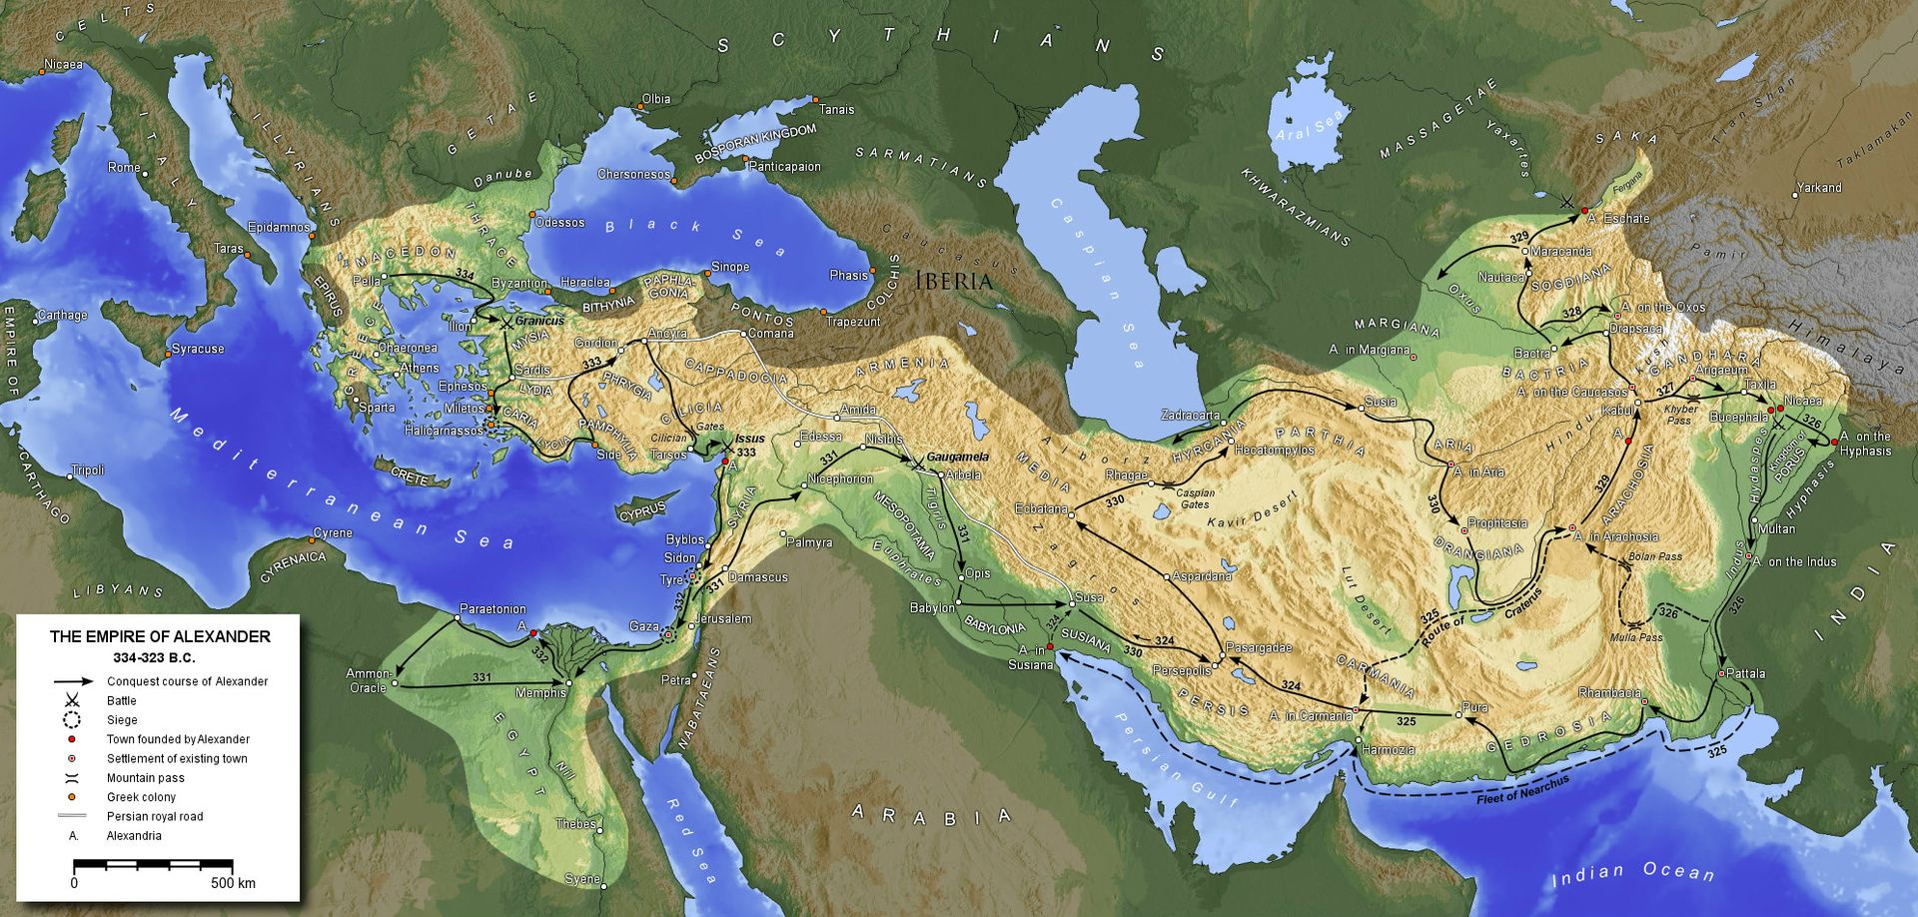
Alexander the Great’s Greek Empire

Slide 16
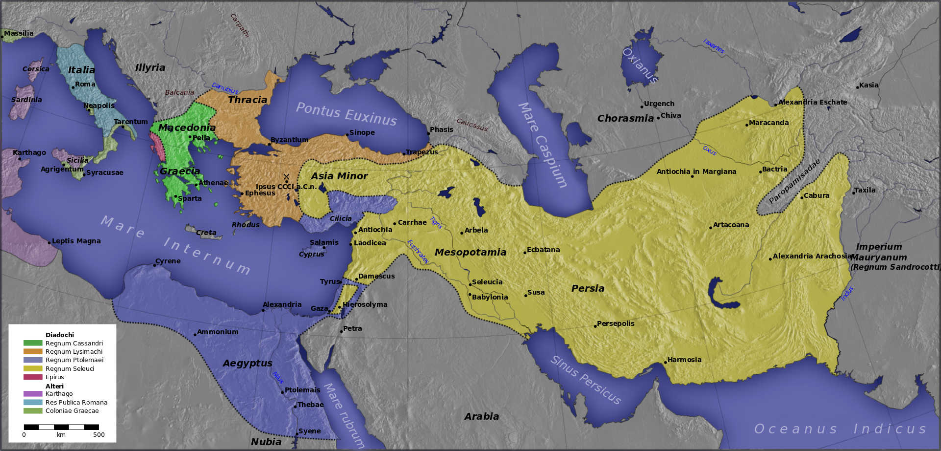
The Divided Greek Empire

Slide 17
The Divided Greek Empire in Dan 11
Verse
Northern Kingdom Western Kingdoms Southern Kingdom
4
Seleucus Nicator
Lysimachus
Cassander
Ptolemy
5
Seleucus Nicator
Ptolemy
Eventually conquered by Seleucus
6
Antiochus II
Marriage of Ptolemy II’s daughter Berenice to Antiochus II
Ptolemy II
7-9
Seleucus II
Ptolemy III, brother of Berenice, invades Northern Kingdom
Ptolemy III
10-12
Antiochus III “The Great”
Constant warfare from 226 BC to 217 BC Egypt victorious, but Antiochus III lives
Ptolemy IV
13-16
Antiochus III “The Great”
Invasion in 201 BC Only stopped by threat from Rome
Ptolemy V
17
Antiochus III “The Great”
Alliance by Marriage Cleopatra I marries Ptolemy V
Ptolemy V
18-19
Antiochus III “The Great”
Antiochus III wages war without support from Egypt – stopped by Rome
Ptolemy V
20
Seleucus III
Faced with heavy tribute to Rome, raises heavy taxes and plunders temple - poisoned

Slide 18
Daniel’s 70 weeks – Dan 9:24-27
70 weeks
7 weeks
62 weeks
1 week
445 BC
Literally “70 weeks of years”
Starts with command to rebuild Jerusalem
Not just return (i.e. end of Babylonian captivity)
Not just temple (i.e. Cyrus in 539 BC) – Ezra 1:1-4
Entire City – Artaxerxes Longimanus – Neh 2:1-8
Historians agree, Artaxerxes decree was in 445 BC
“Streets shall be rebuilt, and the wall”
Nehemiah describes the utter ruin – Neh 2:11-14

Slide 19
Daniel’s 70 weeks – Dan 9:24-27
70 weeks
7 weeks
62 weeks
1 week
445 BC
31 AD
After 62 weeks, Messiah is cut off
Jewish years are 360 days
483 Jewish years (69x7) = 476 Gregorian years
End of the 62 weeks is 31 AD
70th week is yet to come – the Great Tribulation
This is why the Jews reject Daniel as a Prophet – This is the clearest prophecy indicating Christ is the Messiah!

Slide 20
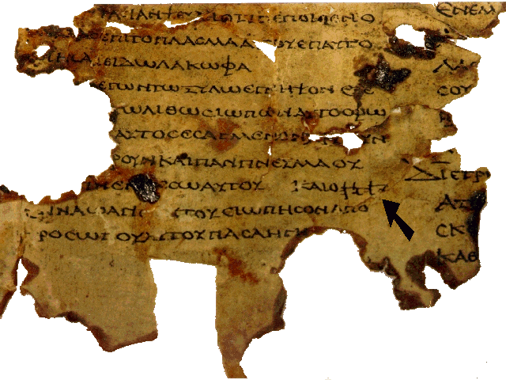
Septuagint (LXX) and Judah Maccabees
Intertestamental Witness

Slide 21
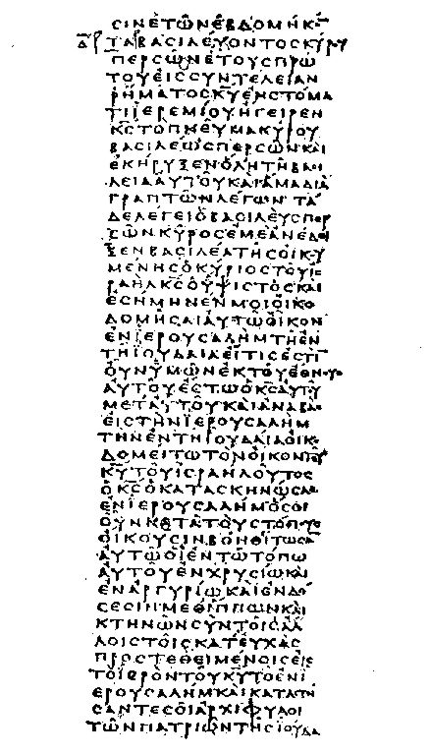
LXX – Greek translation of the OT
Most important translation
King of Egypt - requested translation
Ptolemy II – 285-247 BC
72 scribes in Alexandria
OT available to Jews
few could speak Hebrew
fewer could read
OT available to Gentiles
Desire without ability to learn

Slide 22
Septuagint (LXX) Greek translation of the OT
Quoted by our Lord Jesus, NT Writers, & NT Church
LXX = quoted by our Lord Jesus and NT Writers
²The Pharisees came and asked Him “Is it lawful for a man to divorce his wife?” testing Him… ⁵And Jesus answered and said to them…⁶But from the beginning of the creation, God ‘made them male and female’. ⁷ ‘For this reason a man shall leave his father and mother and be joined to his wife, ⁸and the two shall become one flesh. ¹⁰Therefore, what God has joined together let no man separate.” (Mk 10:2-10),
Hebrew says “they” LXX says ‘two’ eliminates polygamy.
170 of the 283 NT direct quotes of the OT are from LXX that’s 60% [170/283].
LXX was the OT Bible of the Early Church
Extensively used both Jews & Gentiles

Slide 23
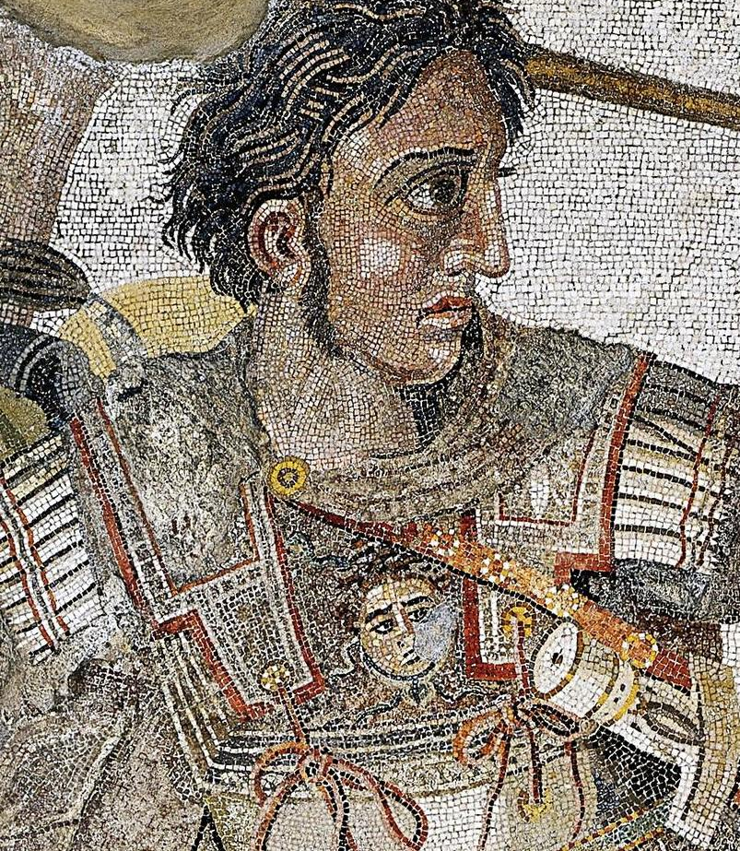
Alexander the Great 356 – 323 BC Lived 32 yrs. Reigned 13 yrs. (336-323)

Slide 24
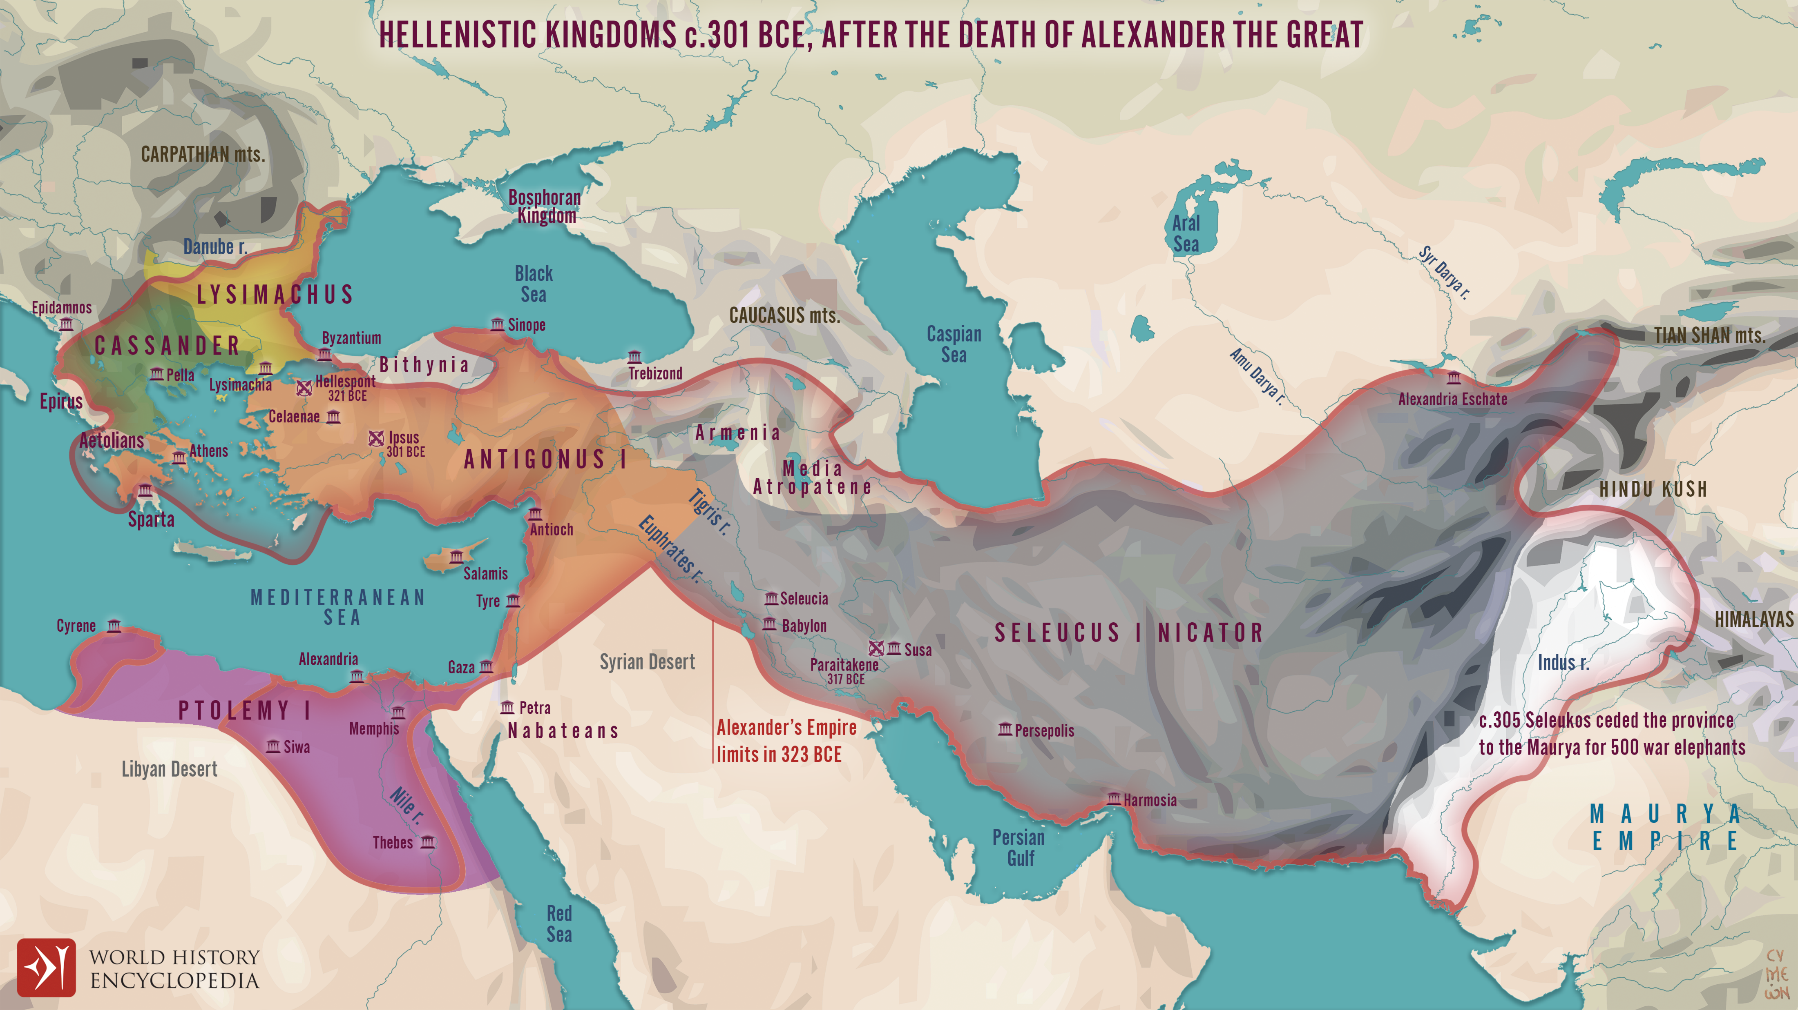

Slide 25
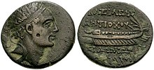
Antiochus IV Epiphanes, (Greek: “God Manifest”) also called Antiochus Epimanes (the Mad), (born c. 215 BCE—died 164,
Antiochus attacked Egypt to prevent an Egyptian expedition to Palestine.
He called on the people to become more Greek (Hellenistic). Jason, the High Priest, built a gym in Jersualem and began to teach young people in the Greek model of Education.

Slide 26
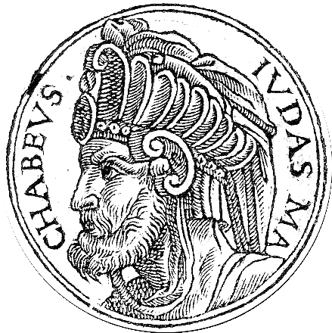
In 167, Antiochus returned from Egypt he took Jerusalem by storm and enforced its Hellenization.
All worship of Jehovah was forbidden on pain of death. An altar to Zeus was erected in the Temple in Jerusalem and sacrifices were made to the image of the King (idolatry) as well as defiled the temple.
Judas Maccabeus, a Jewish priest led a revolt, used guerrilla warfare, and defeated the Syrian generals of Antiochus IV.
Their War cry was Ex. 15:11 “Who is like You, O Lord, among the gods.” After liberating Jerusalem
Judas Maccabeus
“the hammer”

Slide 27
Their War cry was Ex. 15:11 “Who is like You, O Lord, among the gods.”
After the Maccabeus liberated Jerusalem and purified the temple. They fought to liberate all of Judah.
Antiochus died, but Philip his commander-in-chief continued to fight. Philip returned to Antioch to seize power from Lysias, the regent for the young Antiochus V. Lysias decided for peace, the terms included religious freedom to the Jews.
Judas Maccabeus
“the hammer”

