Slide 1
1st Samuel
2nd Samuel
1st Kings chapters 1-11
1st Chronicles chapters 10-29
2nd Chronicles chapters 1-9
Psalms
Proverbs
Ecclesiastes
Song of Solomon
Biblical Roadmap Saul, David, & Solomon

Slide 2
Biblical Roadmap Saul, David, & Solomon
Philistia
United Kingdom
112 yrs.
4.0
1010
970
930
4.1
4.2
4.3
Samson 20 yrs
1350
1300
1250
1200
1150
1100
1050
1000
950
900
Eli
Samuel
80 yrs
Divided
Kingdom
40 yrs
5
120 yrs
1134
1094
1014

Slide 3
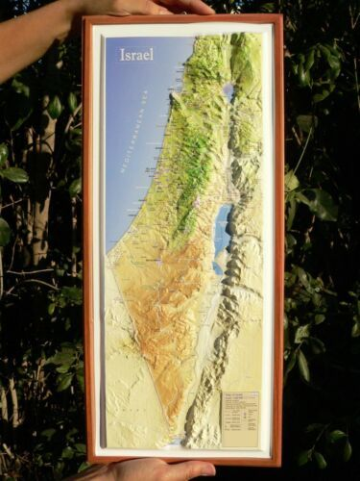
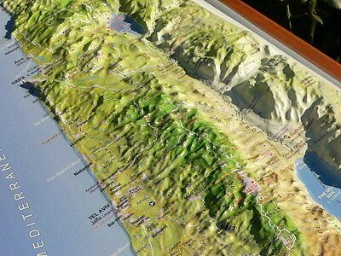

Slide 4
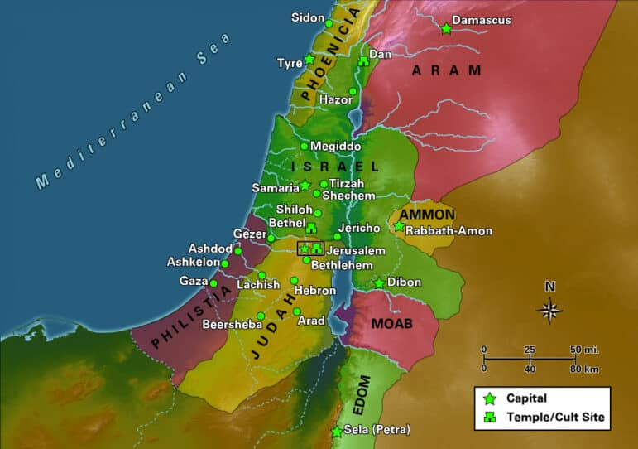

Slide 5
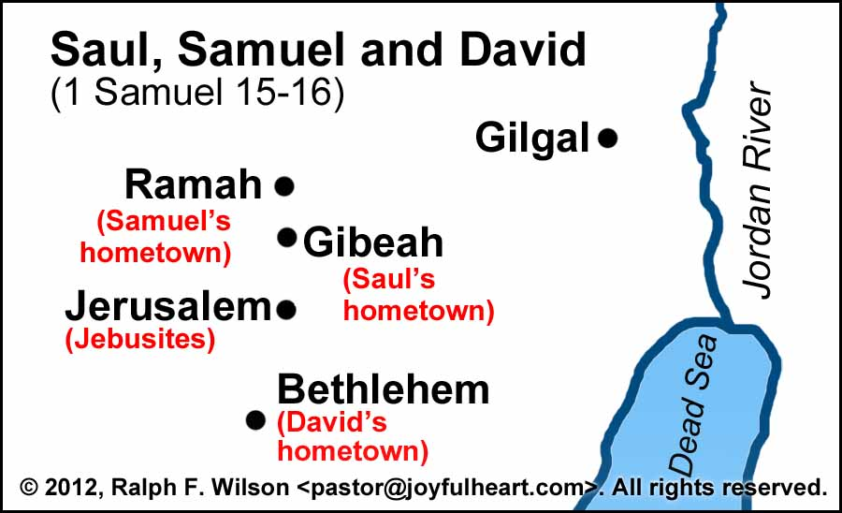

Slide 6
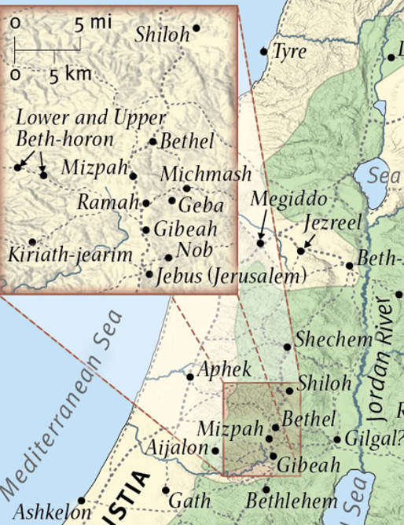
Biblical Narrative connected to Geography
(Beth)el -House of God
(Beth)lehem - Bread
Shiloh - God’s gift & Peace…in pain
Mizpah – Place of radical change.
Ebenezer – up to now… place of remembrance
Gilgal – cutting off the flesh.

Slide 7
Biblical Narrative connected to People who obeyed God (by faith)
Unfaithful
Priest
Eli vs. Samuel
1 Sam 2:35
Saul vs. Jonathan
1 Sam 13:3,14:6
Saul vs. David
1 Sam 13:14
Faithful Priest
Obedient & Courageous Son
Disobedient & Cowardly King
Jealous
Man
Man after God’s

Slide 8
Solomon Timeline
1,000 BC
975 BC
950 BC
925 BC
900 BC
850 BC
David
970 BC
990 BC
CIVIL WAR
Solomon
CIVIL WAR
Solomon
930 BC
Temple Built – 960 BC
Egypt
Siamun
Phoenicians
Hiram
Caananites
Assyrians
Tiglath-Peliser II
Greeks
Greek City States

Slide 9
David to Solomon
After the sin with Bathsheba, we see a different David.
Less action, less leadership, seems gun shy
Conflict for the crown
Sons of David in line for the throne
1st Born - Amnon – Commits great sin, David does nothing, killed by Absolom
2nd Born - Chileab – doesn’t appear on the scene, maybe has already died as well
3rd Born - Absolom – kills Amnon, revolts and leads to civil war. Absolom killed by Joab
4th Born - Adonijah – tries to take throne while David is still alive.
Solomon – Anointed to be King before David dies
Adonijah tries to take the throne AGAIN after David dies by asking for one of David’s harem to be his wife. Solomon executes him.

Slide 10
David to Solomon
1 Chronicles 22:8-10, “And David said to Solomon: “My son, as for me, it was in my mind to build a house to the name of the Lord my God; but the word of the Lord came to me, saying, ‘You have shed much blood and have made great wars; you shall not build a house for My name, because you have shed much blood on the earth in My sight. Behold, a son shall be born to you, who shall be a man of rest; and I will give him rest from all his enemies all around. His name shall be Solomon, for I will give peace and quietness to Israel in his days. He shall build a house for My name, and he shall be My son, and I will be his Father; and I will establish the throne of his kingdom over Israel forever.”

Slide 11
David to Solomon
Isaiah 56:7 – “These I will bring to my holy mountain, and make them joyful in my house of prayer; their burnt offerings and their sacrifices will be accepted on my altar; for my house shall be called a house of prayer for all peoples.”
1 Kings 6:12 - “Concerning this temple which you are building, if you walk in My statutes, execute My judgments, keep all My commandments, and walk in them, then I will perform My word with you, which I spoke to your father David. And I will dwell among the children of Israel, and will not forsake My people Israel.”

Slide 12
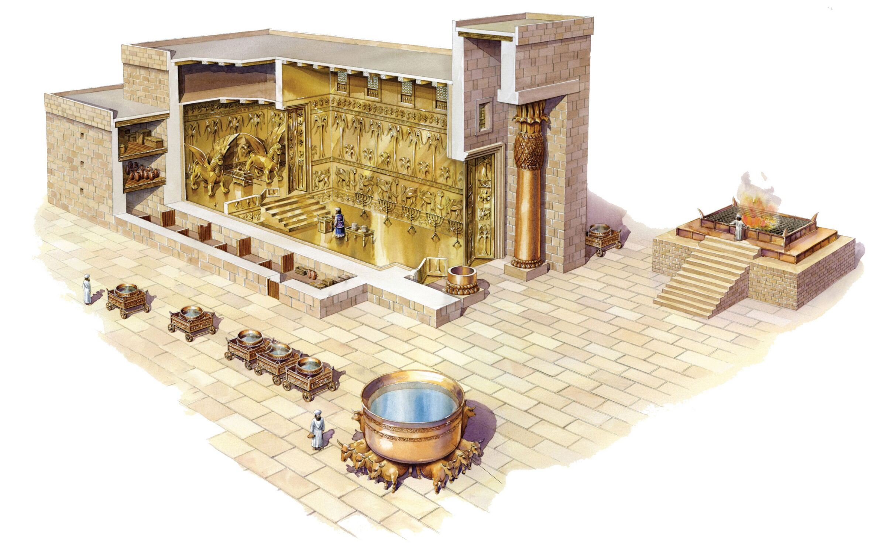

Slide 13
Solomon Riches
1 Kings 10:23, “Thus King Solomon excelled all the kings of the earth in riches and in wisdom.”
Riches
(1 Kings 10:14-15) Solomon’s yearly income.
“The weight of gold that came to Solomon yearly was six hundred and sixty-six talents of gold, besides that from the traveling merchants, from the income of traders, from all the kings of Arabia, and from the governors of the country.”
A talent ≈ 75 U.S. pounds = 1,094 troy ounces.
$1,600 per troy ounce, talent = $1,750,400.
Solomon received 666 talents of the metal each year.
≈ $1,165,766,400 U.S. dollars PER YEAR, MINIMUM

Slide 14
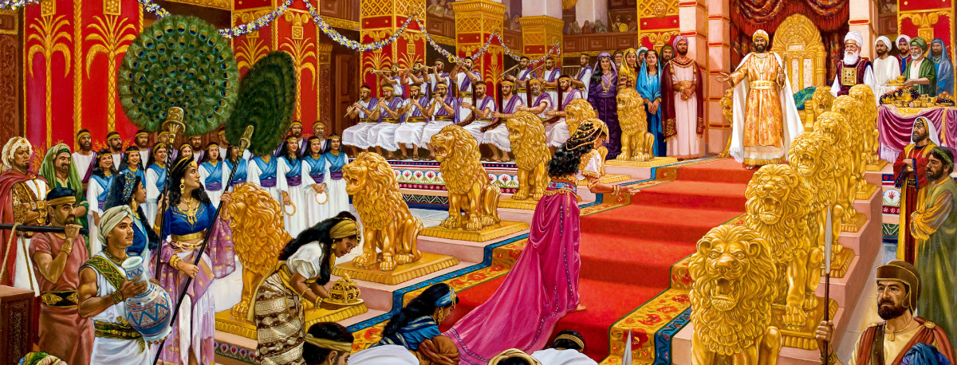
Solomon’s Riches
Palaces – in Multiple Cities
Fortresses and armories
Navy and fleets of ships
Horsemen/Chariots
Trade routes
International trade routes
Gardens
Zoos

Slide 15
Solomon’s Wisdom
1 Kings 10:23, “Thus King Solomon excelled all the kings of the earth in riches and in wisdom.”
1 Kings 10:3-8, “So Solomon answered all her questions; there was nothing so difficult for the king that he could not explain it to her. And when the queen of Sheba had seen all the wisdom of Solomon, the house that he had built, the food on his table, the seating of his servants, the service of his waiters and their apparel, his cupbearers, and his entryway by which he went up to the house of the LORD, there was no more spirit in her. Then she said to the king: “It was a true report which I heard in my own land about your words and your wisdom. However, I did not believe the words until I came and saw with my own eyes; and indeed, the half was not told me. Your wisdom and prosperity exceed the fame of which I heard. Happy are your men and happy are these your servants, who stand continually before you and hear your wisdom! Blessed be the LORD your God, who delighted in you, setting you on the throne of Israel! Because the LORD has loved Israel forever, therefore He made you king, to do justice and righteousness.”

Slide 16
Solomon’s Districts
1 Kings 4:7-28
Solomon instituted 12 districts, which didn’t follow the tribal lands that they were given in Joshua
Each district was to provide for the royal household once per year
Each district had a governor that reported to Solomon.
However, Judah was not included in those districts, they did not have to pay tribute and support the throne.
This will become an issue after Solomon dies
Vs. 20 – God’s people were prospering, eating, drinking and rejoicing!
1 Kings 9:22
Solomon also put the nations of the people who’s land that Israel took into servitude. He didn’t put any of God’s people in service.
(SPOILER ALERT)

Slide 17
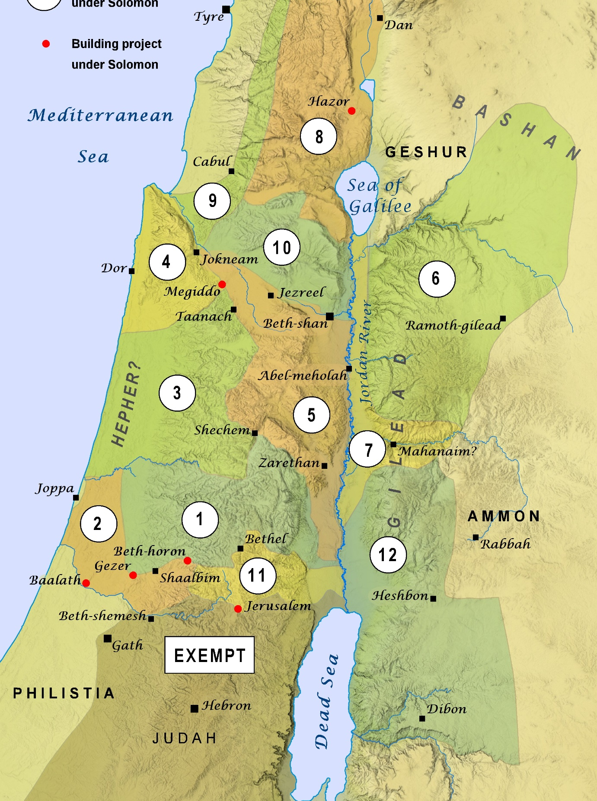
District 1 – Mountains of Ephraim
Governor – Ben-Hur
District 2 – Makraz
Governor – Ben-Deker
District 3 – Arubboth
Governor – Ben-Hesed
District 4 – Dor
Governor – Ben-Abinadab (Solomon’s Son-in-Law)
District 5 – Taanach
Governor – Baana
District 6 – Ramoth Gilead
Governor – Ben-Geber
District 7 – Mahanaim
Governor – Ahinadab
District 8 - Naphtali
Governor – Ahimaaz (Solomon’s Son-in-Law)
District 9 – Asher and Aloth
Governor – Baanah
District 10 - Issachar
Governor – Jehoshaphat
District 11 - Benjamin
Governor – Shimei
District 12 – Gilead
Governor – Geber

Slide 18
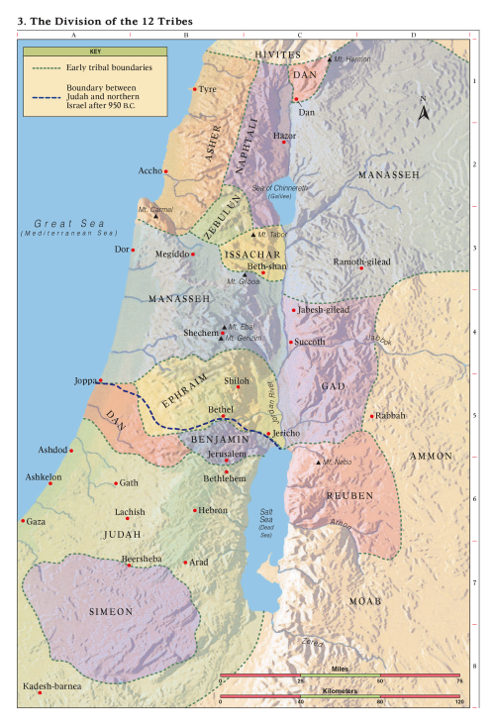

Slide 20
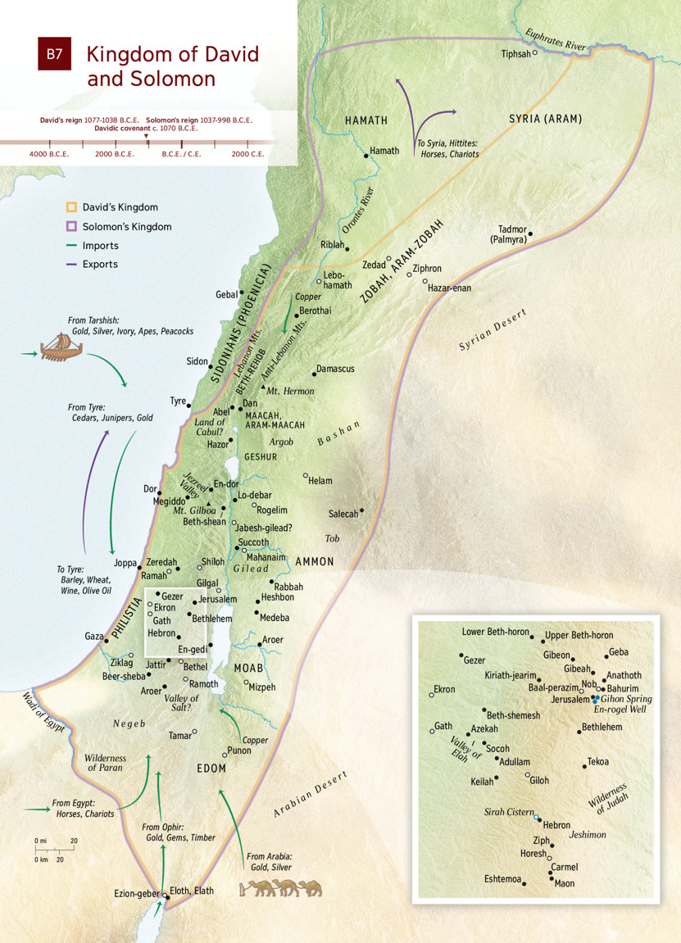

Slide 21
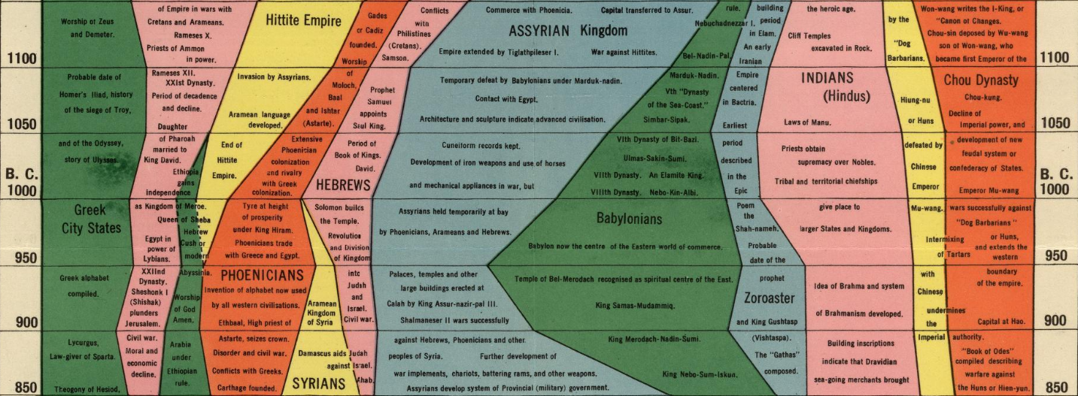

Slide 22
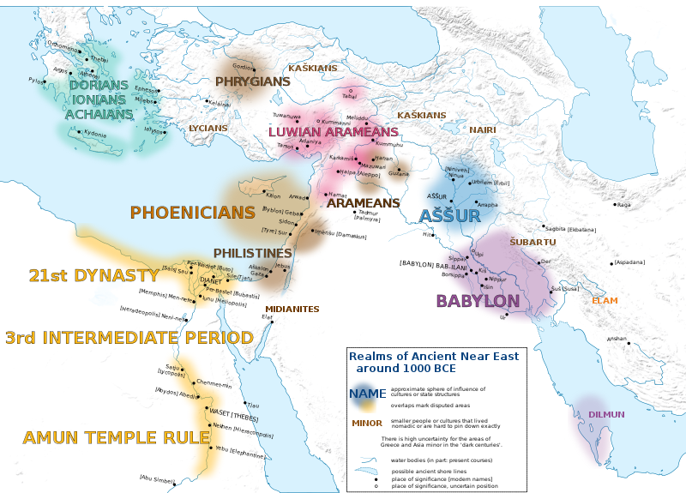

Slide 23
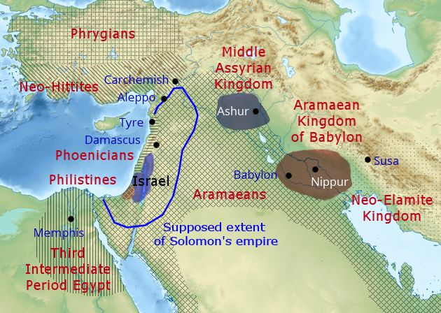

Slide 24
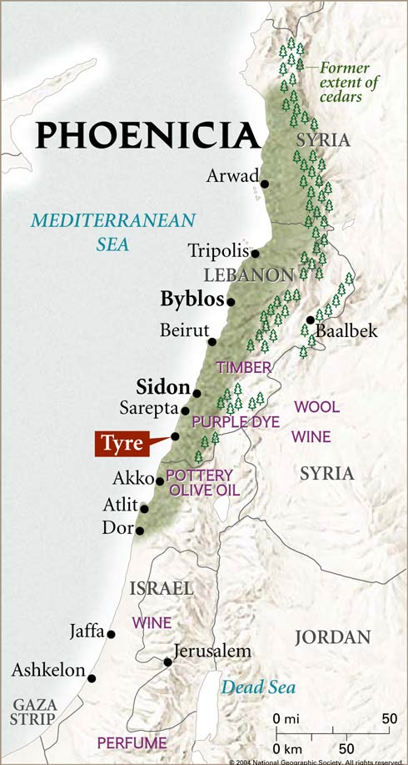

Slide 25
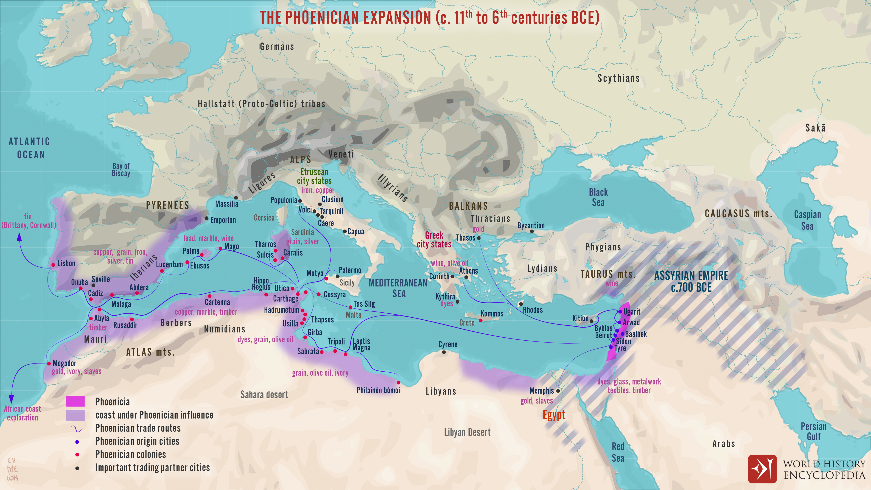

Slide 26
Solomon’s Mistakes
He let things slip, and not follow the Lord’s Laws
Deuteronomy 17:16-17 – “But he shall not multiply horses for himself, nor cause the people to return to Egypt to multiply horses, for the LORD has said to you, ‘You shall not return that way again. And he shall not acquire many wives for himself, lest his heart turn away, nor shall he acquire for himself excessive silver and gold.”

Slide 27
Solomon’s Mistakes – Relying on the World
Horses & Chariots
Deuteronomy 17:16 – “But he shall not multiply horses for himself, nor cause the people to return to Egypt to multiply horses,
1 Kings 10:25, 26, 28-29
Vs. 25, “Each man brough his present: … HORSES”
Vs. 26, “Solomon gathered chariots and horsemen, 1,400 chariots and 12,000 horsemen, he stationed in CHARIOT CITIES and with the king at Jerusalem.
Vs. 28, “Also Solomon HAD HORSES IMPORTED FROM EGYPT, and the king’s merchants bought them and exported them to all the kings of the Hittites and the kings of Syria”

Slide 28
Solomon’s Mistakes – Dividing His Heart
Nehemiah 13:25-27 – “So I contended with them and cursed them, struck some of them and pulled out their hair, and made them swear by God, saying, “You shall not give your daughters as wives to their sons, nor take their daughters for your sons or yourselves. Did not Solomon king of Israel sin by these things? Yet among many nations there was no king like him, who was beloved of his God; and God made him king over all Israel. Nevertheless, pagan women caused even him to sin. Should we then hear of your doing all this great evil, transgressing against our God by marrying pagan women?”

Slide 29
Solomon Timeline
1,000 BC
975 BC
950 BC
925 BC
900 BC
850 BC
David
970 BC
990 BC
Solomon
Solomon
930 BC
Temple Built – 960 BC
Egypt
Siamun
Phoenicians
Hiram
Caananites
Assyrians
Tiglath-Peliser II
Greeks
Greek City States

Slide 30
Solomon’s Idol Worship
1 Kings 11:1-8
Egyptians – Egyptian Pantheon
Moabites – Chemosh
Ammonites – Molech
Edom - Qos
Phoenicians – Ashtoreth
Caananites – Baal
Phillistines - Dagon
Practices:
Temple prostitution (male and female) (Ashtoreth)
Child sacrifice (Molech)
Idol worship (all)
Obscene images (Ashtoreth)
Rituals
Abuse
Perversion

Slide 31
Solomon’s Consequences
Kingdom that God established with him will be taken away
1 Kings 6:6-8 - Solomon allowed and entered into worship of false gods and so will the people
Next week we will see the results of Solomon’s mistakes
1 Kings 11:35 – God is handing 10 tribes over to Jeroboam, Solomon’s servant
Rehoboam will rule over Judah and Benjamin for a time
The temple will be destroyed in 926 BC by Pharoah Shishak in 926 BC
1 Kings 14:25 – “He took away EVERYTHING”
God’s people will go back to the apostasy and idol worship that that have always done

