Slide 1
Flood to Egypt
Genesis 9 – 50
2298 BC – 1590 BC

Slide 2
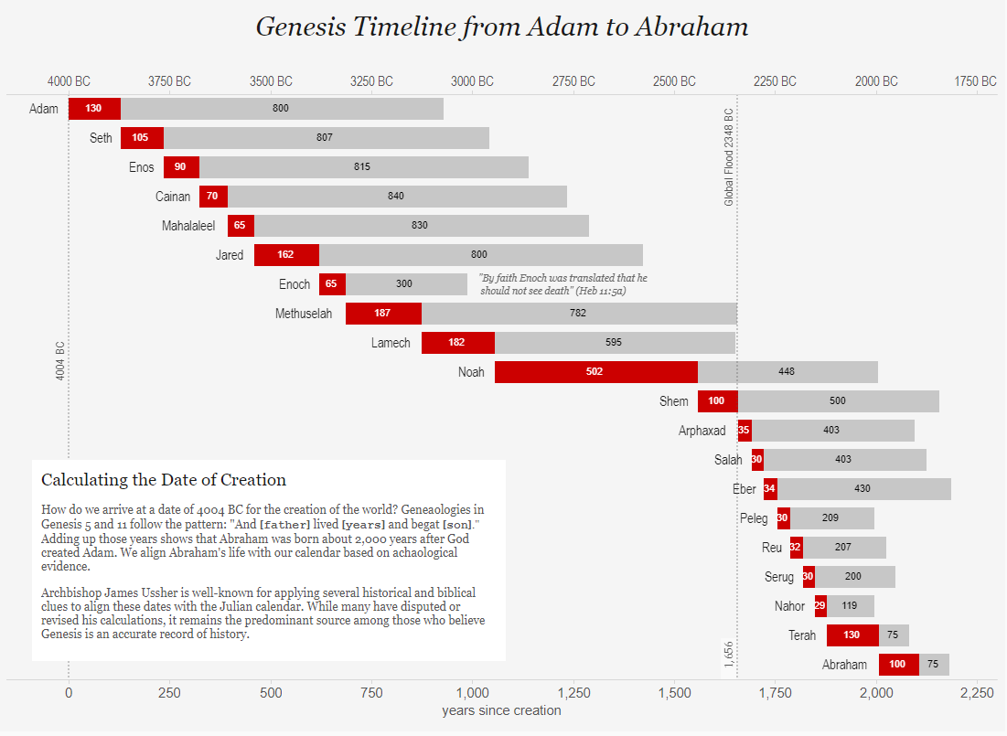

Slide 3
The Times They Are A-Changin’

Slide 4
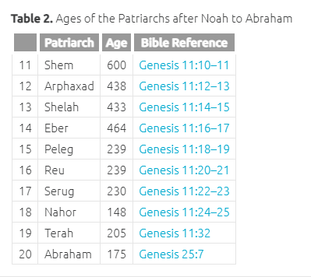
Ages of the Patriarchs

Slide 6
Population Genetics
“According to a new study, all of Earth's people, according to a new analysis of the genomes of 53 populations, fall into just three genetic groups.” – Washington Post, 2009

Slide 7
People on the move!
Genesis 6:1,
“And God blessed Noah and his sons, and said unto them, “Be fruitful, and multiply, and fill the earth.”
Genesis 11:1-2,
“And the whole earth was of one language, and of one speech.
“And it came to pass, as they journeyed from the east, that they found a plain in the land of Shinar; and they dwelt there.”

Slide 8
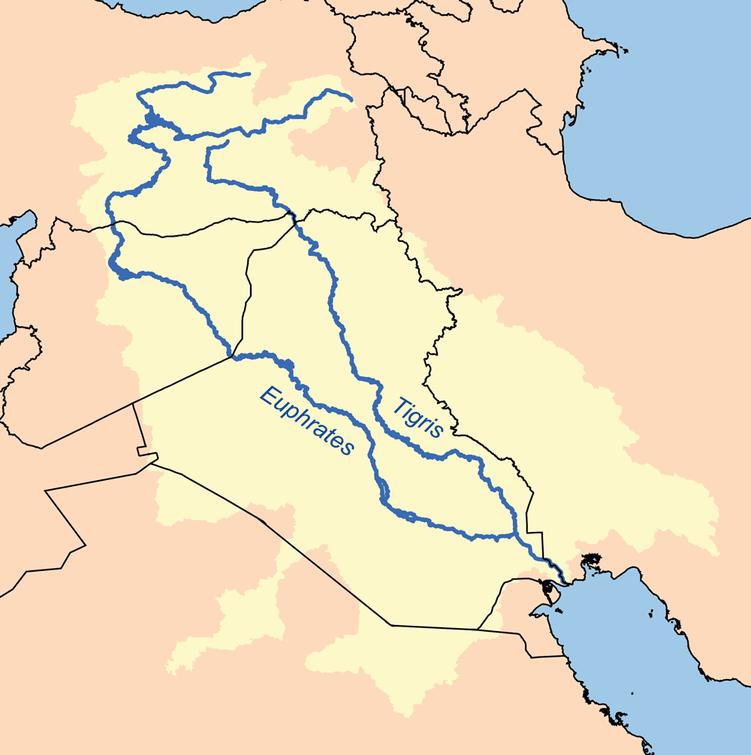

Slide 9
Tower of Babel

Slide 10
Tower of Babel (2200 BC)

Slide 11
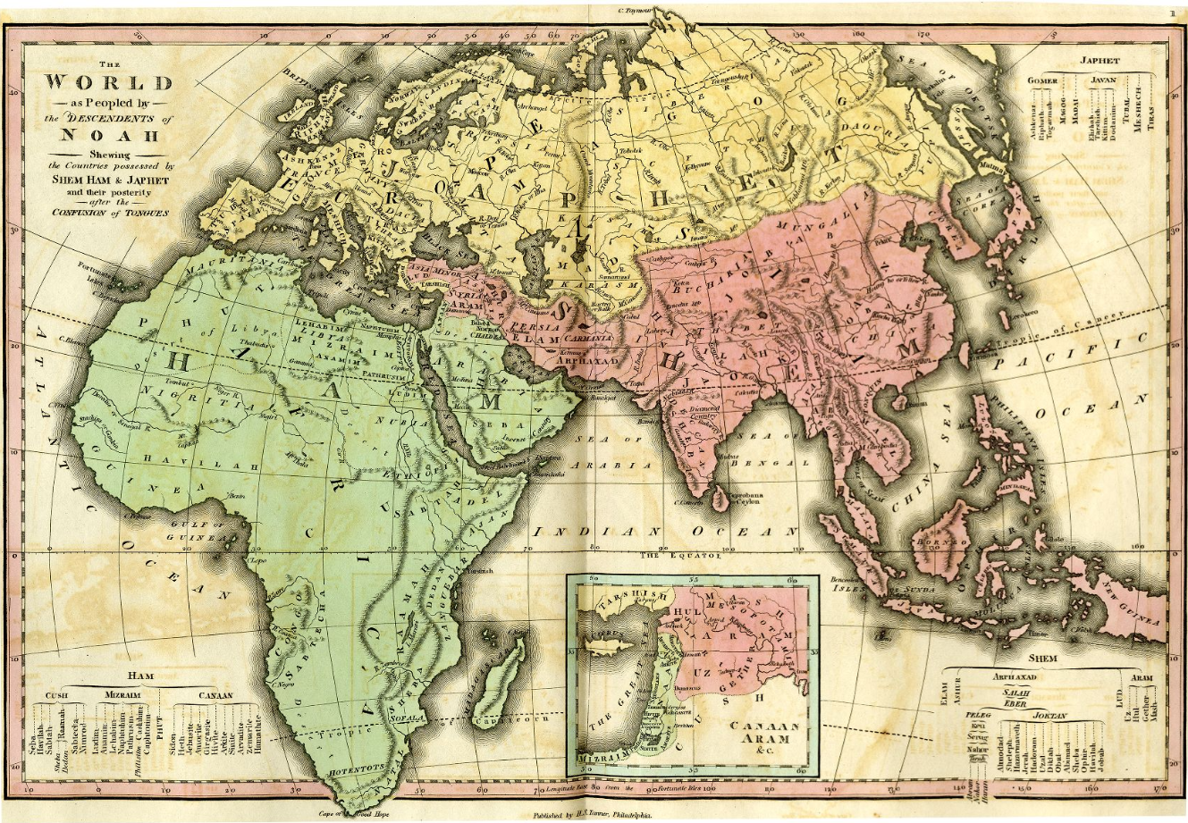

Slide 12
The Nations
Egypt (Mizraim)
Abraham – Gen. 12:10
Joseph – Gen 39:1
Chaldeans (Ur)
Abram – Gen 11:28
Job 1:17
Canaanites (Ham)
Abram – Gen. 15:18-21
Moses – Ex. 3:8,17
Joshua
Philistines
Abraham – Gen 21:32
Judges 3:3
David – 1 Sam. 17:1
Assyrians (Nimrod)
Isaiah 8:4
Ezek. 23:5
Babylonians (Nimrod)
Daniel 1:1
Greeks (Javan)
Romans

Slide 13
Greece
Egypt

Slide 14
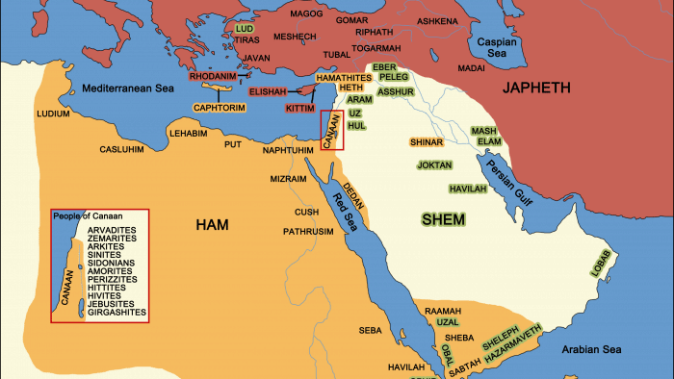

Slide 15
Nations
ABRAHAM

Slide 17
Tower of Babel (2200 BC)
Job
2185 BC)

Slide 18
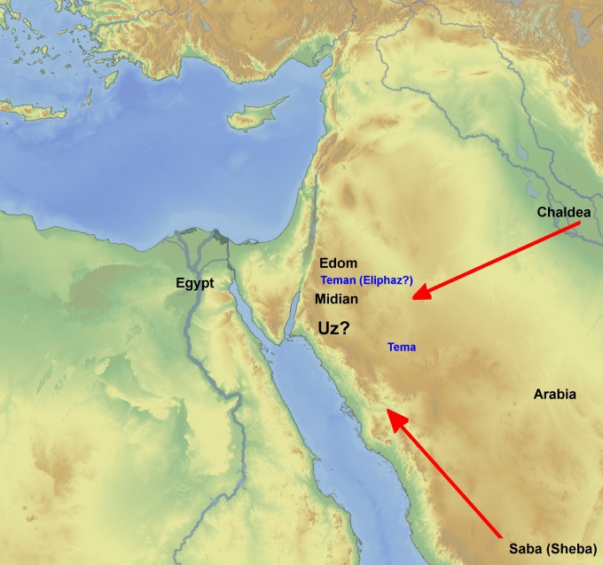

Slide 19
Dispensations
Human Government
Test: Use government to do what is right – Gen 9:6
Tower of Babel (2200 BC)
Ultimate Failure: Babel
Ultimate Judgement: Confusion of Language
Job
2185 BC)
Promise
Test: Believe God will keep his Promise
Gen 12:1-3
Ultimate Failure: ???
Ultimate Judgement: ???
Innocence
Conscience
Human
Government
Promise

Slide 20
Sources:
Genesis Timeline – Adam to Abraham - https://viz.bible/visualizing-the-genesis-timeline-from-adam-to-abraham/
Histomap - https://www.davidrumsey.com/luna/servlet/view/search?search=SUBMIT&cat=0&q=the+histomap+four+thousand+years+of+world+history&dateRangeStart=&dateRangeEnd=&sort=pub_list_no_initialsort%2Cpub_date%2Cpub_list_no%2Cseries_no&QuickSearchA=QuickSearchA

