Slide 1
OT Timeline - Week 7
The Babylonian Captivity
605 BC – 535 BC
Daniel

Slide 2
???
605
Receives prophecy that God will destroy Judah - repents
1st Babylonian invasion – 10,000 taken captive
Start of Babylonian Captivity
Nahum
Habakkuk
Zephaniah
Jeremiah
Ezekiel
Sides with Egypt against Babylon
Sides with Babylon against Egypt
643
641
609
Manasseh
Josiah
Jehoiakim
650
Amon
625
Jehoahaz
600
Kingdom of Judah
Prophet to Israel
Prophet to Both
Prophet to Other
or
Bad King
Good King
King starts good and ends bad

Slide 3
598
586
2nd Babylonian invasion – Jehoiachin imprisoned
3rd Babylonian invasion
Prophecy given to Manasseh:
2 Ki 21:13b-14a - …I will wipe Jerusalem as a man wipeth a dish, wiping it, and turning it upside down. And I will forsake the remnant of mine inheritance, and deliver them into the hand of their enemies…
Habakkuk
Zephaniah
Jeremiah
Ezekiel
598
586
Jehoiakim
Zedekiah
600
Jehoiachin
575
550
Kingdom of Judah
Prophet to Israel
Prophet to Both
Prophet to Other
or
Bad King
Good King
King starts good and ends bad

Slide 4
Reign of Nebuchadnezzar II
605 BC – 562 BC
605 BC – 1st invasion of Jerusalem – Start of captivity
Dan 3 - Shadrach, Meshach, Abednego and the Fiery Furnace
Exact year unknown
Dan 4 - Nebuchadnezzar’s 2nd Dream and subsequent 7 years of Madness
Exact year unknown
Jeremiah 52:31
And it came to pass in the seven and thirtieth year of the captivity of Jehoiachin king of Judah, in the twelfth month, in the five and twentieth day of the month, that Evilmerodach king of Babylon in the first year of his reign lifted up the head of Jehoiachin king of Judah, and brought him forth out of prison
562
560
Evil Merodach
Nergal-shar-usur
556
Nabonidas / Belshazzar
539

Slide 5
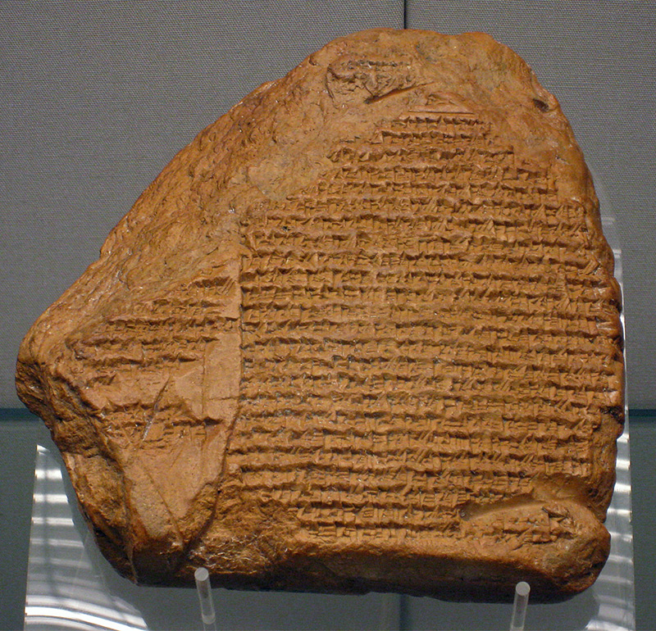
Who was Belshazzar
Nabonidus Chronicle tablet
Translated in 1882
Gives account of Nabonidus rule
He lived in Arabia for 10 of his 17 years
His son Belshazzar ruled in his stead

Slide 6
Reign of Nebuchadnezzar II
605 BC – 562 BC
605 BC – 1st invasion of Jerusalem – Start of captivity
Dan 3 - Shadrach, Meshach, Abednego and the Fiery Furnace
Exact year unknown
Dan 4 - Nebuchadnezzar’s 2nd Dream and subsequent 7 years of Madness
Exact year unknown
562
560
Evil Merodach
Nergal-shar-usur
556
Nabonidas / Belshazzar
Dan 5 - Writing on the wall
Night of fall of Babylon
539
539 BC – Fall of Babylon

Slide 7
Median – Persian Royal Families
Medes
Persians
Cyaxares I
Astyages
Cyrus I

Slide 8
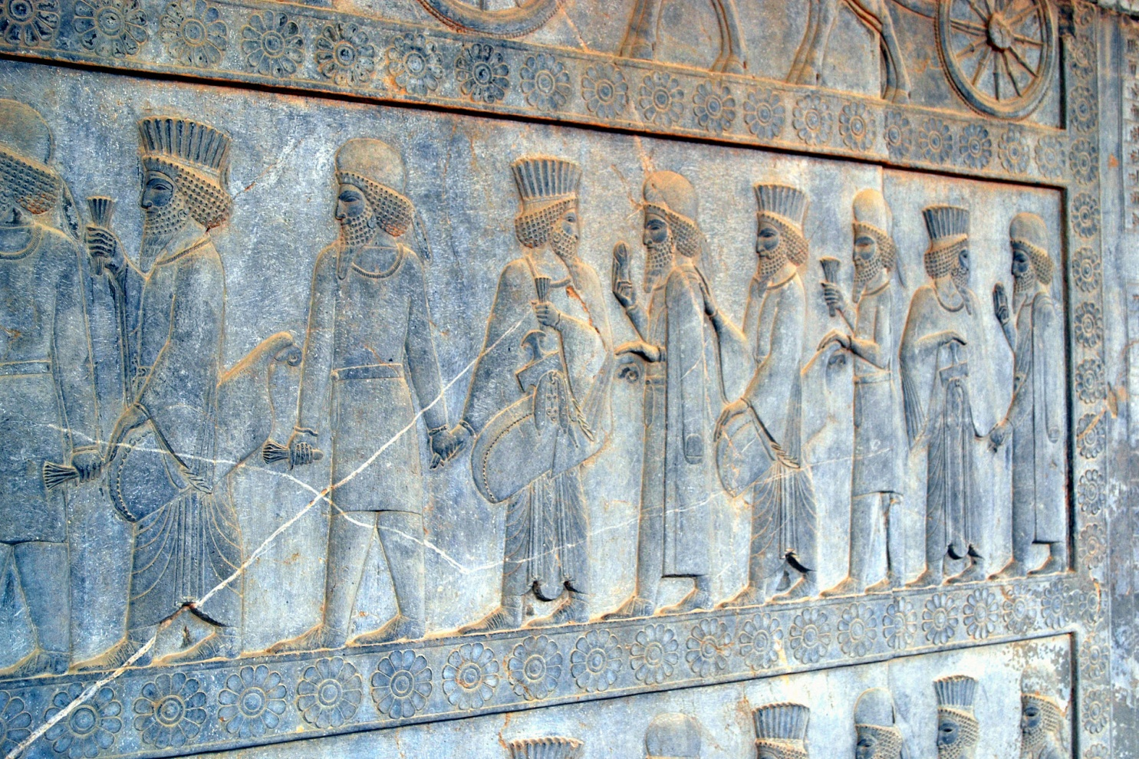
Archaeological evidence of Medio-Persian Alliance
Persepolis Reliefs
Show Medes and Persians as equals
Round hat = Mede
Box hat = Persian

Slide 9
Median – Persian Royal Families
Medes
Persians
Cyaxares I
Astyages
Cyrus I
Cyaxares II
Princess
Mandane
Cambyses I
Cyrus II
“the Great”

Slide 10
Reign of Nebuchadnezzar II
605 BC – 562 BC
605 BC – 1st invasion of Jerusalem – Start of captivity
Dan 3 - Shadrach, Meshach, Abednego and the Fiery Furnace
Exact year unknown
Dan 4 - Nebuchadnezzar's 2nd Dream and subsequent 7 years of Madness
Exact year unknown
562
560
Evil Merodach
Nergal-shar-usur
556
Nabonidas / Belshazzar
Dan 5 - Writing on the wall
Night of fall of Babylon
539
539 BC – Fall of Babylon
Dan 6 - Daniel and the lion’s den
Exact year unknown – during Darius
Darius the Mede
536
Cyrus the Great
535 BC – Decree to return to the land

Slide 11
Timeline
605 BC
535 BC
Israel in Babylon
600
575
550
525
500

Slide 12
Egypt
In Decline
About 100 years before Judah and Benjamin go into captivity, Egypt’s power was waning, but around 600 BC, they were having a renaissance of sorts. With the introduction of Greek ideas had brought about a rise in power and influence.
However, after the teaming with the Assyrian campaign against the Median/Persians, they are defeated, and they become a Persian province.

Slide 13
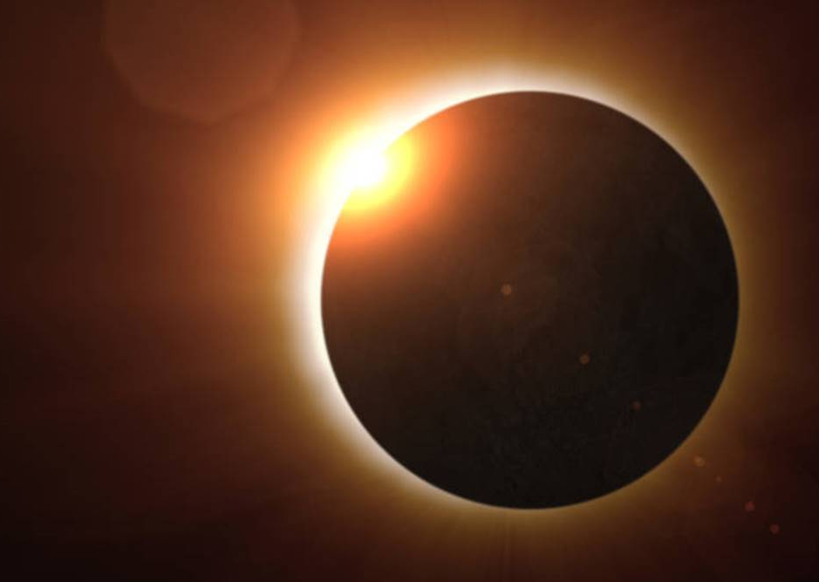
Battle of the Eclipse
Battle between the Medes and Lydians in 585 BC.
Greek philosopher Thales of Miletus predicted the event!
Aylattes, the king of Lydia, was battling Cyaxares, king of the Medes, probably near the River Halys in what is now central Turkey.
The battle was happening when the sun became dark, and they called a truce!

Slide 14
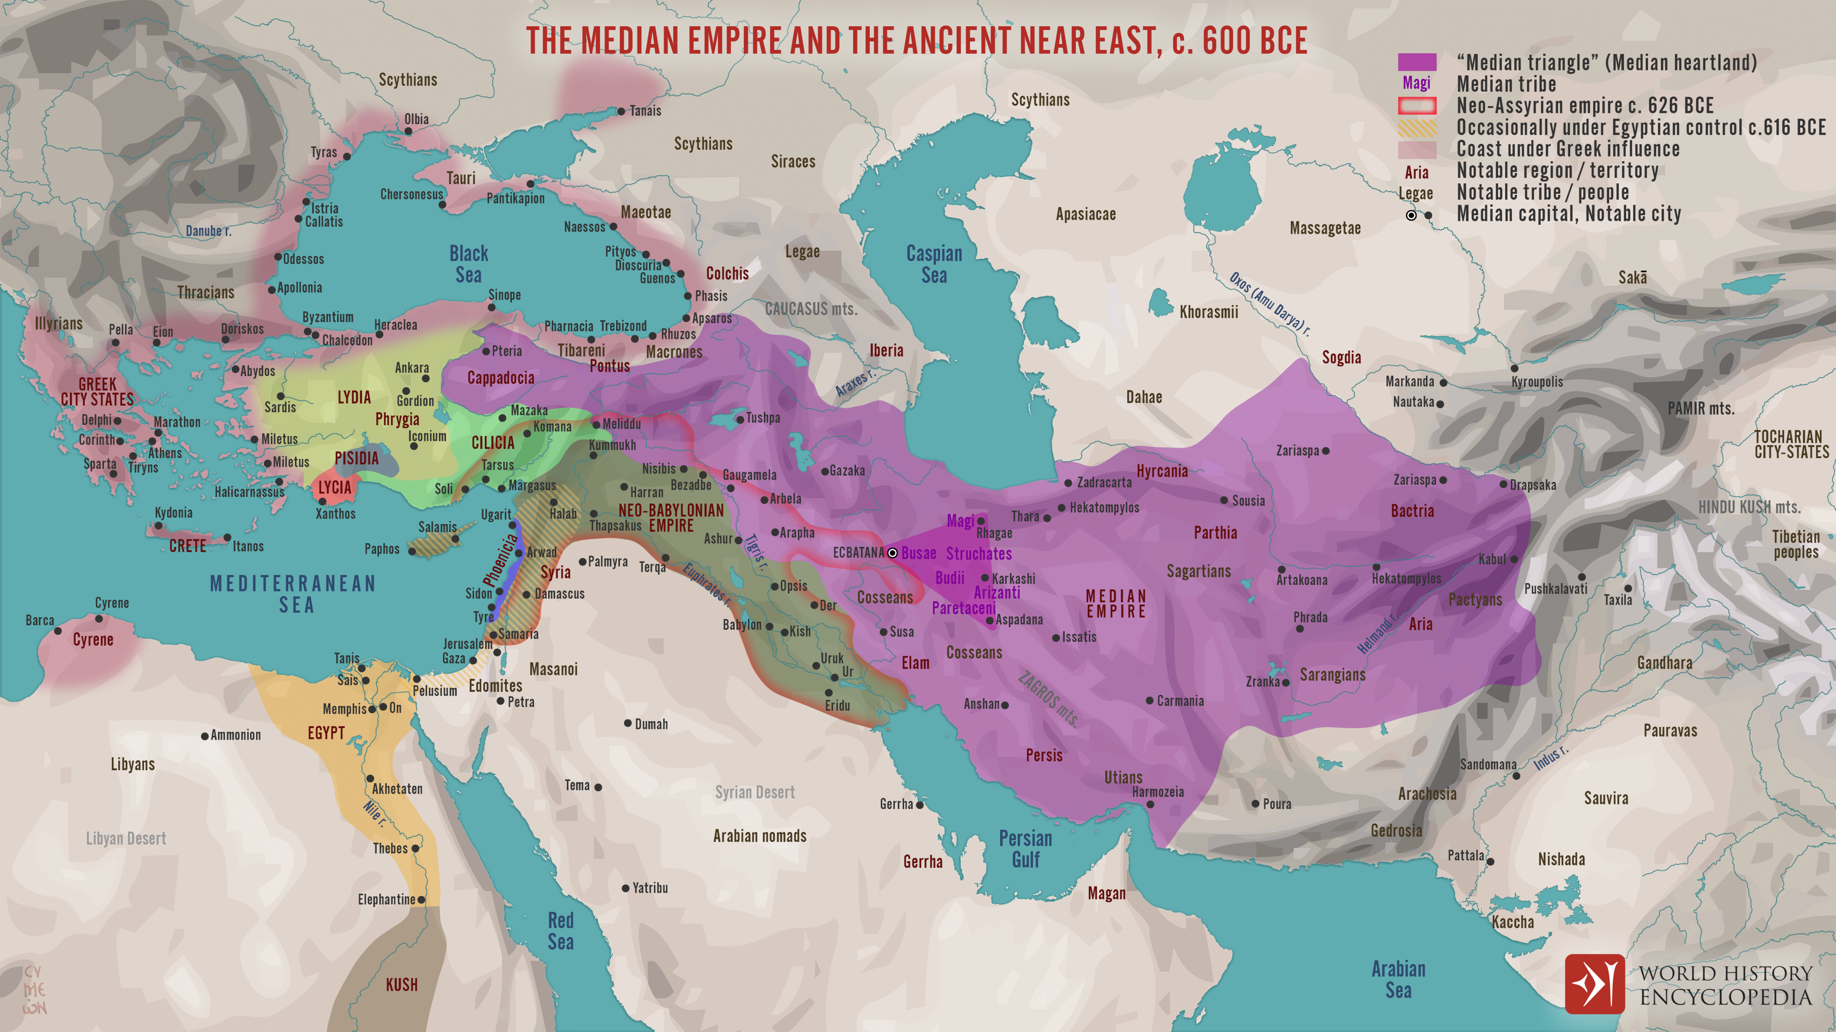

Slide 15
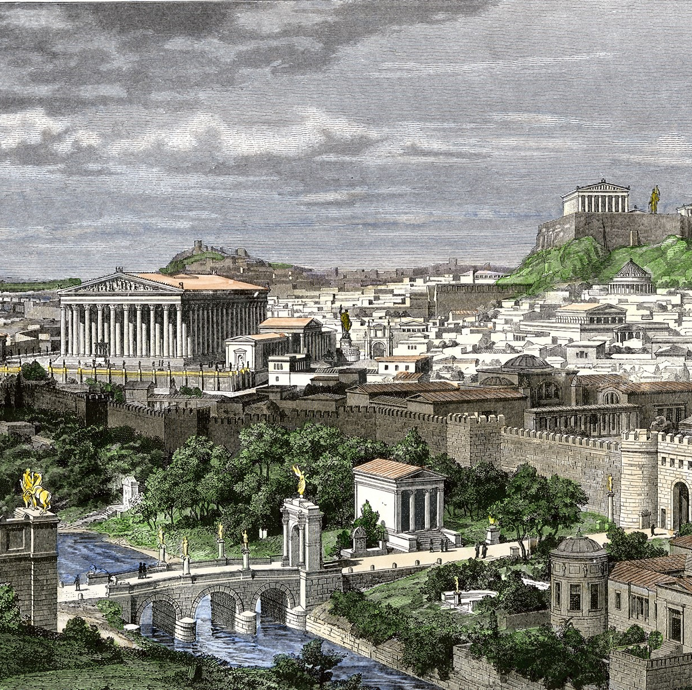
Greeks
Greek City States are beginning to emerge
Athína (Athens)
Spárti (Sparta)
Kórinthos (Corinth)
Thíva (Thebes)
Siracusa (Syracuse)
Égina (Aegina)
Ródos (Rhodes)
Árgos
Erétria
Elis

Slide 16
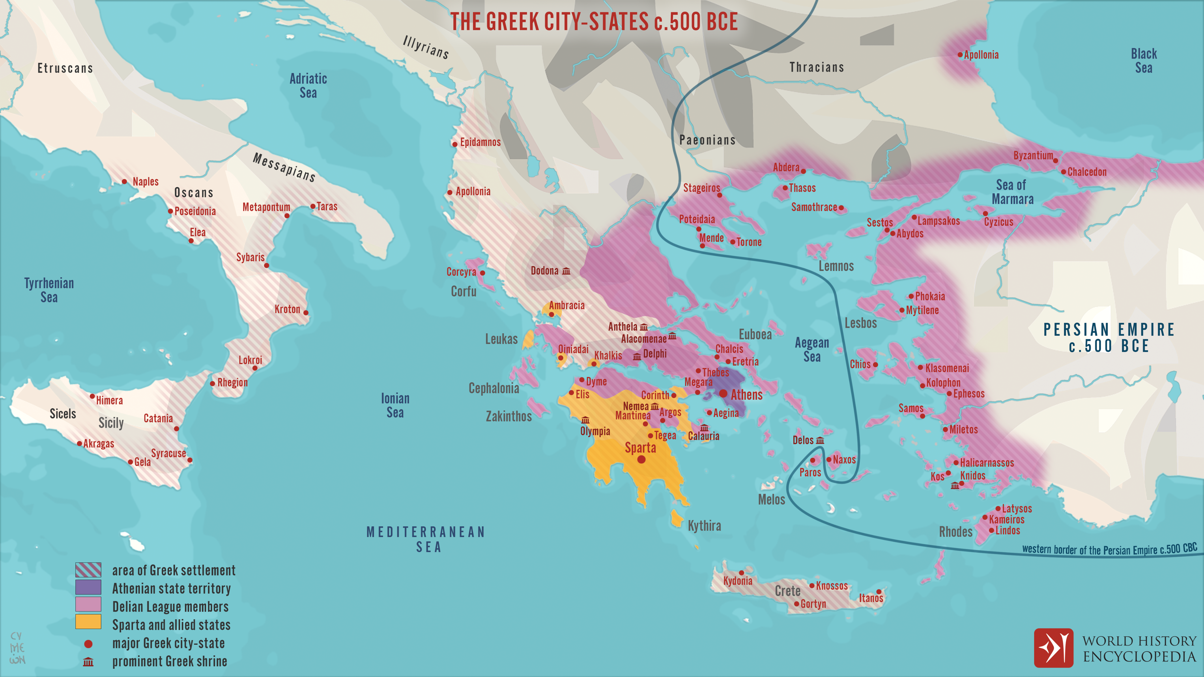

Slide 17
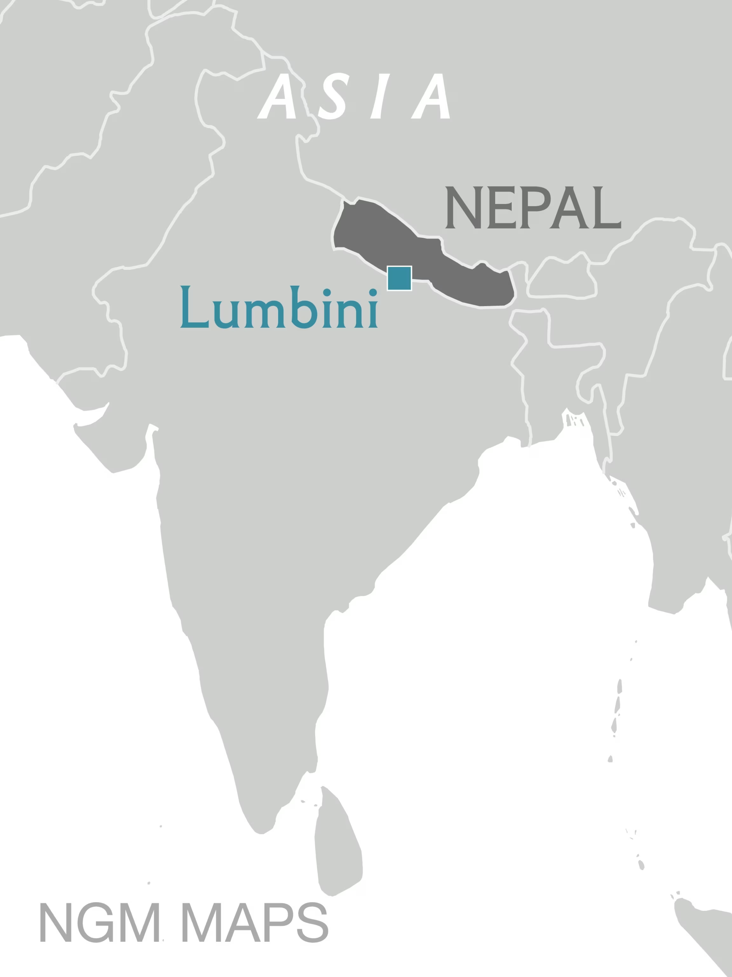
India
Siddartha Guatama – “the Buddha”
Born 560 BC, Lumbini Nepal
Prince in a wealthy family, the top caste in India
Was troubled by human suffering, and set out to find enlightenment
Unfortunately, he didn’t find it.
Died 483 BC
4th Largest religion in the world, to this day

Slide 18
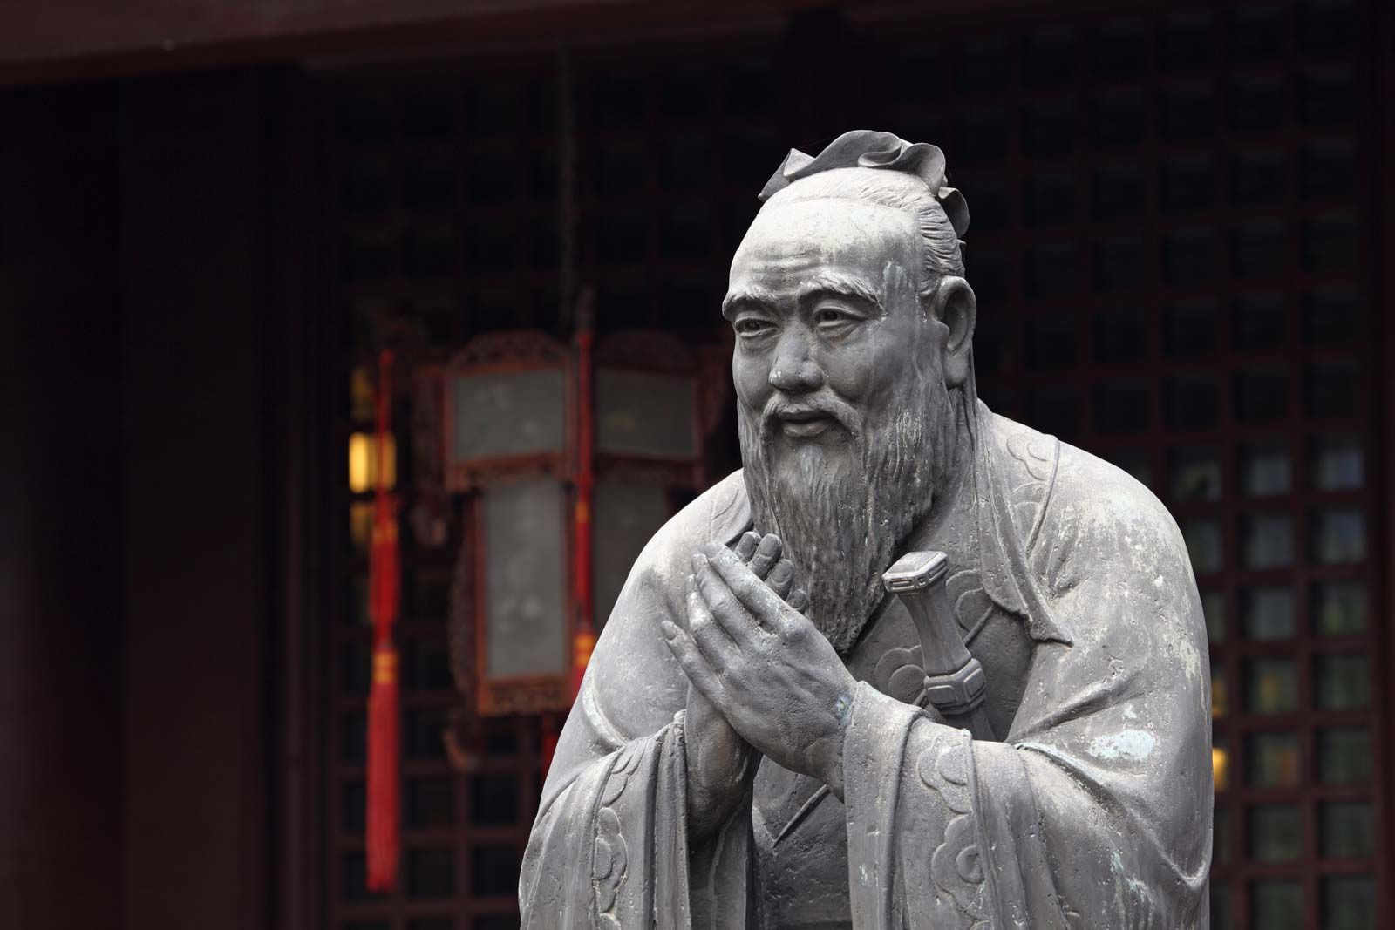
China
Confucius (551 BC – 479 BC)
Philosopher – believed in strong moral character, turned into a pseudo-religion.
The Zhou Dynasty had been ruling since 11th century BC, but now is losing control, and China is breaking up into separate states.
"Warring States,"
Qi, Chu, Yan, Han, Wei, Zhao, Qin, and Zhou.
All these states still carried the feudal system

Slide 19
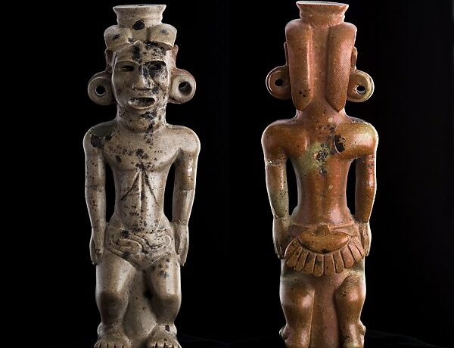
Adena Peoples
Ohio River Valley
Adena Mound - Chillicothe, Ohio
Built extraordinary mound structures for burials.
Some research has shown that they may have had giants in those days, up to and over 7 feet tall

Slide 20
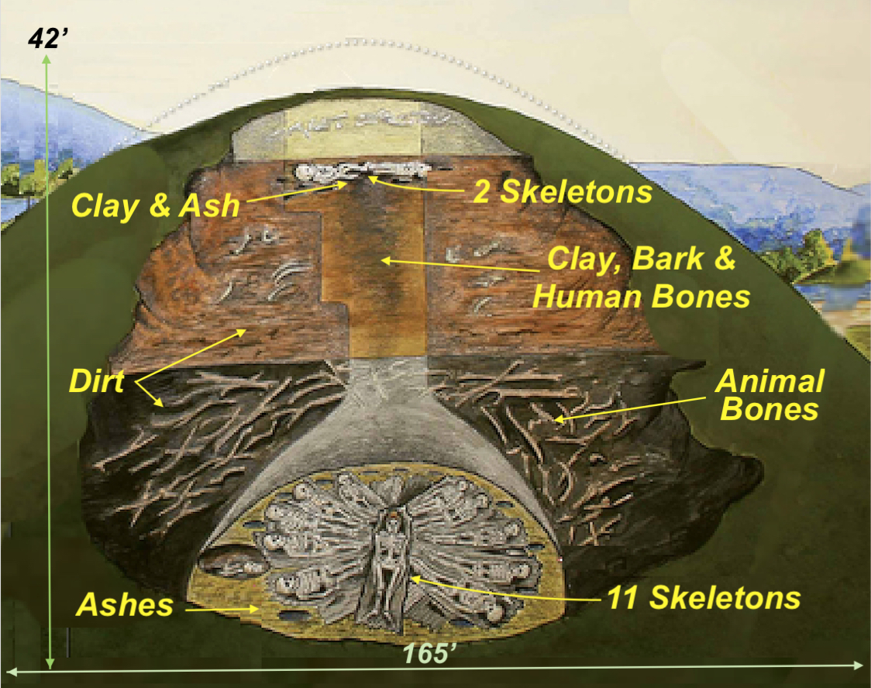

Slide 21
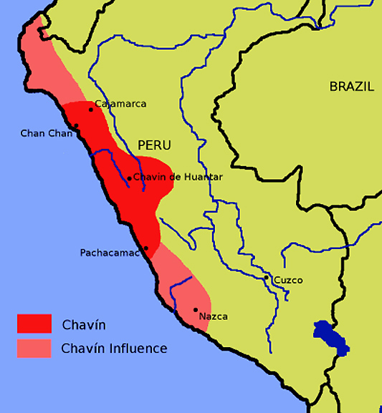
Chavin Culture (South America)
1,700 years before the Incan Empire
They were known for their sophisticated art and architecture, including their use of underground passageways and ventilation systems in their temples.

Slide 22
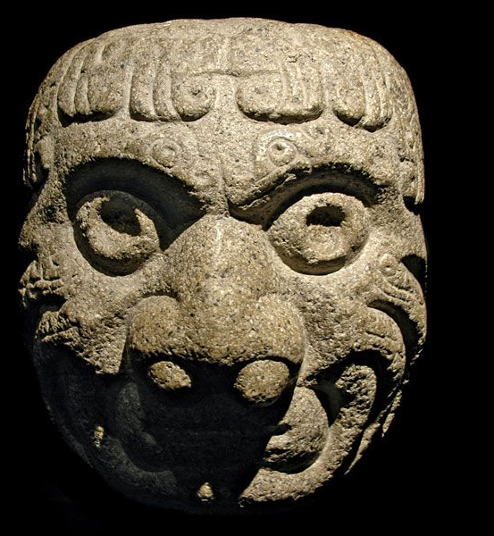
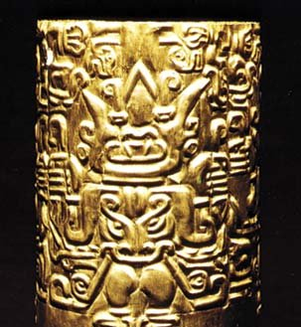

Slide 23
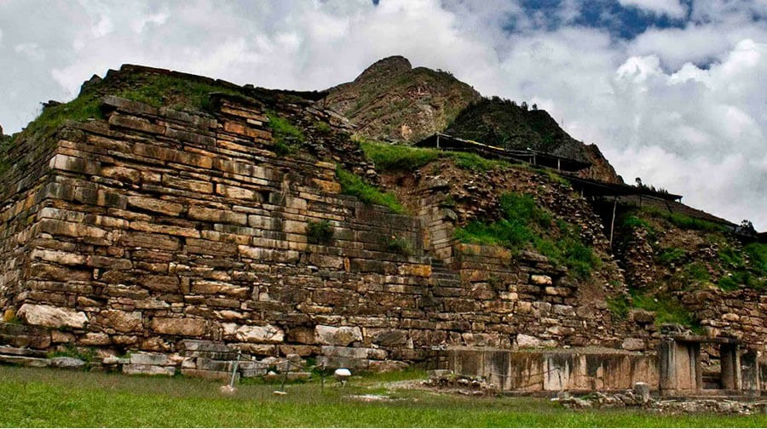

Slide 24
Timeline
605 BC
Battle of the Eclipse – 585 BC
“Buddha” is born – 560 BC
535 BC
Israel in Babylon
600
575
550
525
500
Confucius is born – 551 BC

