Slide 1
The Great Deception
2 Thessalonians 2:8-10

Slide 2
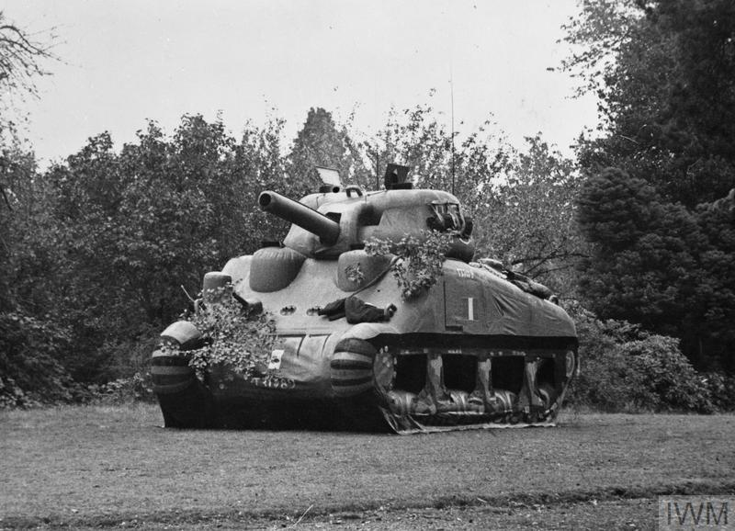
The Ghost army

Slide 3
roadmap
Characters and Works
Build a Timeline
The “Great Deception”

Slide 4
Characters and works
Man of Sin (vs. 3)
The Restrainer (vs. 7)
The Lawless One (vs. 8)
Satan (vs. 9)
God (vs. 11)

Slide 5
The Man of sin
A.K.A. the “Antichrist”
Revealed when he sets himself in place of God
Sits in the temple
Demands worship

Slide 6
The restrainer
(some of) The Holy Spirit’s Functions
Indwelling
“…in whom also, having believed you were sealed with the Holy Spirit of Promise”
-Ephesians 1:13
Convicting
“And when He [Holy Spirit] has come, he will convict the world…”
-John 16:8
Inspires Scripture
“This Scripture… which the Holy Spirit spoke before by the mouth of David…”
-Acts 1:16
Performs Signs
“[Jesus Christ was] declared to be the Son of God with power according to the Spirit of holiness…”
-Romans 1:4

Slide 7
The restrainer
Confirming Signs
Confirming a Promise
“Surely I will take the stick of Joseph… and I will join them with it, with the stick of Judah, and make them one stick, and they will be one in My hand”
-Ezekiel 37:23
Confirming the Gospel
“And they went out and preached everywhere, the Lord working with them and confirming the word through the accompanying signs.”
-Mark 16:20
Confirms God Himself
“Let it be known this day that you are God in Israel and I am Your servant, and that I have done all these things at Your word.”
-1 Kings 18:36
Confirming a Lie
“[The false prophet] performs great signs, so that he even makes fire come down from heaven on the earth in the sight of men.”
-Revelation 13:13

Slide 8
The lawless one
The Lawless one
2 Thessalonians
The false prophet
Revelation
Destroyed at Second Coming (2:8)
Works signs and wonders (2:9)
Deceives the world (2:10)
Destroyed at Second Coming (19:20)
Works signs and wonders (13:13)
Deceives the world (13:14)

Slide 9
Satan
His works:
Empowers the Antichrist and false prophet
Constructs unholy trinity
Satan as orchestrator and planner
Antichrist receives worship and conquers death
False prophet confirms with signs and directs worship to Antichrist

Slide 10
God
Sends the “strong delusion” (vs. 10-12)
“For the wrath of God is revealed from heaven against all ungodliness and unrighteousness of men, who suppress the truth in unrighteousness… Professing to be wise, they became fools… Therefore God also gave them up to uncleanness”
-Romans 1:18-24

Slide 11
Timeline
“And from the time that the daily sacrifice is taken away, and the abomination of desolation is set up, there shall be one thousand two hundred and ninety days.”
-Daniel 12:11
Start of Tribulation
Abomination of Desolation
End of Tribulation
1,290 days (3.5 yrs.)

Slide 12
Timeline
“Therefore when you see the ‘abomination of desolation’, spoken of by Daniel the prophet… then let those who are in Judea flee to the mountains… For then there will be great tribulation, such as has not been since the beginning of the world…”
-Matthew 24:15-21
Start of Tribulation
Abomination of Desolation
End of Tribulation
“Great Tribulation”

Slide 13
Timeline
“Now, brethren, concerning the coming of our Lord Jesus Christ and our Gathering together to Him…”
-2 Thessalonians 2:1
Rapture
End of Tribulation
Covenant with Israel (Start)
-Daniel 9:27

Slide 14
Timeline
“…the man of sin is revealed, the son of perdition, who opposes and exalts himself above all that is called God or that is worshiped, so that he sits as God in the temple of God, showing himself that he is God.”
-2 Thessalonians 2:3b-4
Rapture
Man of Sin Revealed
End of Tribulation
Covenant with Israel (Start)
-Daniel 9:27

Slide 15
Timeline
“Let no one deceive you by any means; for that day will not come unless the falling away comes first, and the man of sin is revealed…”
-2 Thessalonians 2:3
Rapture
Man of Sin Revealed
End of Tribulation
The Day of the Lord
Covenant with Israel (Start)
-Daniel 9:27

Slide 16
Timeline
“An [the Antichrist] was given a mouth speaking great things and blasphemies, and he was given authority to continue for forty-two months. Then he opened his mouth in blasphemy against God…And [the false prophet] exercises all the authority of the first beast in his presence…”
-Revelation 13:5-12
Rapture
Man of Sin Revealed
End of Tribulation
The Day of the Lord
Covenant with Israel (Start)
-Daniel 9:27
Lawless One Revealed

Slide 17
Timeline
“For the mystery of lawlessness is already at work; only He who now restrains will do so until He is taken out of the way. And then the lawless one will be revealed…”
-2 Thessalonians 2:7-8
Rapture
Restrainer Removed
Man of Sin Revealed
End of Tribulation
The Day of the Lord
Covenant with Israel (Start)
-Daniel 9:27
Lawless One Revealed

Slide 18
Timeline
“And [Antichrist] was given a mouth speaking great things and blasphemies, and he was given authority to continue for forty-two months. Then he opened his mouth in blasphemy against God, to blaspheme His name, His tabernacle, and those who dwell in heaven.”
-Revelation 13:5-6
Rapture
Restrainer Removed
Man of Sin Revealed
End of Tribulation
The Day of the Lord
Covenant with Israel (Start)
-Daniel 9:27
Lawless One Revealed

Slide 19
Timeline
“…and [the gentiles] shall tread the holy city underfoot for forty-two months. And I will give power to my two witnesses, and they will prophesy one thousand two hundred and sixty days, clothed in sackcloth.”
-Revelation 11:2b-3
Rapture
Restrainer Removed
Man of Sin Revealed
End of Tribulation
The Day of the Lord
Covenant with Israel (Start)
-Daniel 9:27
Lawless One Revealed

Slide 20
Timeline
Revelation 17
Union of powerful religious entity with Antichrist (Mystery of Babylon)
Revelation 14
Babylon falls at likely the 3.5 year point of tribulation
Rapture
Restrainer Removed
Man of Sin Revealed
End of Tribulation
The Day of the Lord
Covenant with Israel (Start)
-Daniel 9:27
Lawless One Revealed

Slide 21
Timeline
Conclusion?
Rapture
Restrainer Removed
Man of Sin Revealed
End of Tribulation
The “Falling Away”
The Day of the Lord
Covenant with Israel (Start)
-Daniel 9:27
Lawless One Revealed

Slide 22
Deception
“A systematic fabrication of a false reality”

Slide 23
Mystery of lawlessness
The Bride
The Harlot
Seeks to please husband (Christ)
Clothed in Righteous acts (Revelation 19:7-9)
Seeks to please any man that benefits her
Clothing attracts World (Revelation 17:4)

Slide 24
The Mystery of Lawlessness
“Go therefore and make disciples of all the nations, baptizing them in the name of the Father and of the Son and of the Holy Spirit, teaching them to ovserve all things that I have commanded you”
-Matthew 28:19-20

Slide 25
The Mystery of Lawlessness
“…to the Jews I became as a Jew, that I might win Jews; to those who are under the law, as under the law, that I might win those who are under the law; to those who are without law, as without law (not being without law toward God, but under law toward Christ), that I might win those who are without law… I have become all things to all men, that I might by all means save some. Now this I do for the gospel’s sake that I may be partaker of it with you.”
-1 Corinthians 9:20-23

Slide 26
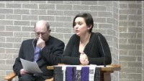
The Mystery of Lawlessness

Slide 27
Conclusion
Scripture command us to strive to live peaceably (Romans 12:18)
Scripture guarantees the world WILL hate those who are godly in Christ Jesus (2 Timothy 2:12)
Draw INDIVIDUALS, don’t try to draw the WORLD (James 4:4)
Preach the truth, love as Christ loved, and be salt and Light!

