Slide 1
OT Timeline Week 5
Divided Kingdom – Israel
931 BC – 722 BC
1 Kings
2 Kings
2 Chronicles
Jonah
Amos
Hosea
Isaiah
Micah

Slide 2
~1500 BC Hindu Vedas and Upanishads written down continues thru ~500 BC
Asia
Europe
Africa
Americas
La Venta becomes Olmec Capital
900 BC
800 BC
700 BC

Slide 3
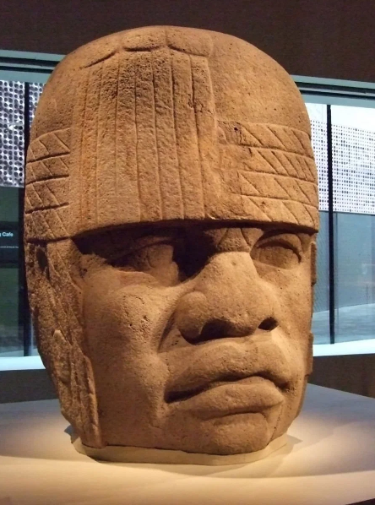
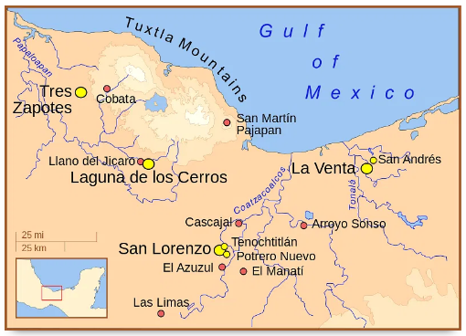
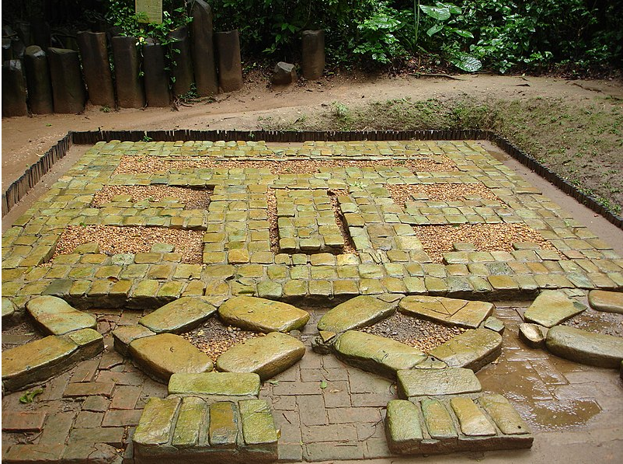
Olmec Civilization in modern Mexico
Mosaic from La Venta
1st capital was San Lorenzo
Moved to La Venta circa 900 BC
Typical “Big Head” sculpture

Slide 4
~1500 BC Hindu Vedas and Upanishads written down continues thru ~500 BC
Asia
Europe
Africa
Americas
La Venta becomes Olmec Capital
Chávin de Huántar – first civilization in South America
900 BC
800 BC
700 BC

Slide 5
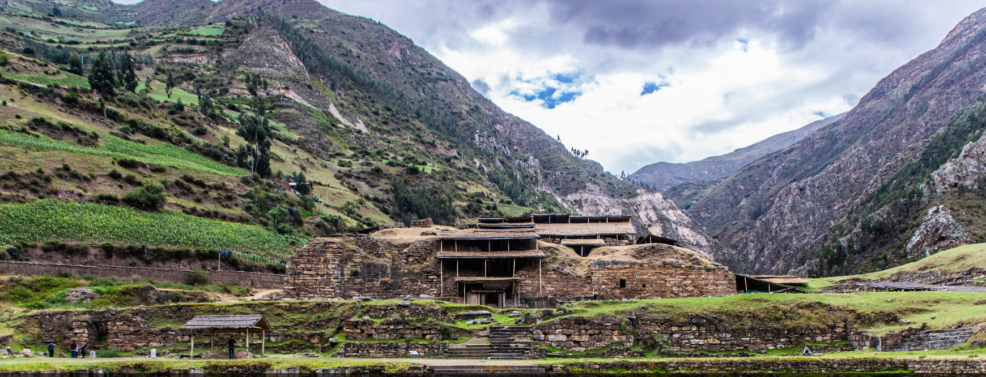
Chávin de Huántar – first civilization in South America
Chávin de Huántar today
Video link to Chavin overview

Slide 6
~1500 BC Hindu Vedas and Upanishads written down continues thru ~500 BC
Party at Nimrud
Asia
Europe
Africa
Americas
La Venta becomes Olmec Capital
Chávin de Huántar – first civilization in South America
900 BC
800 BC
700 BC

Slide 7
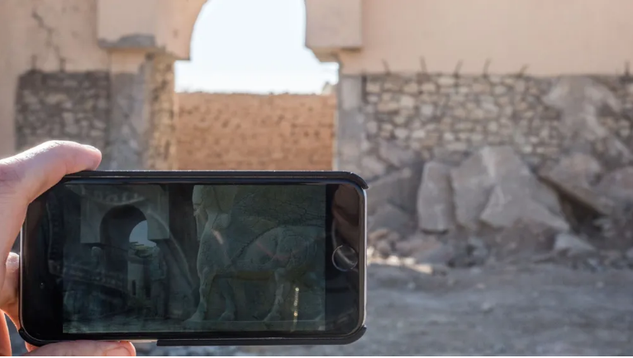
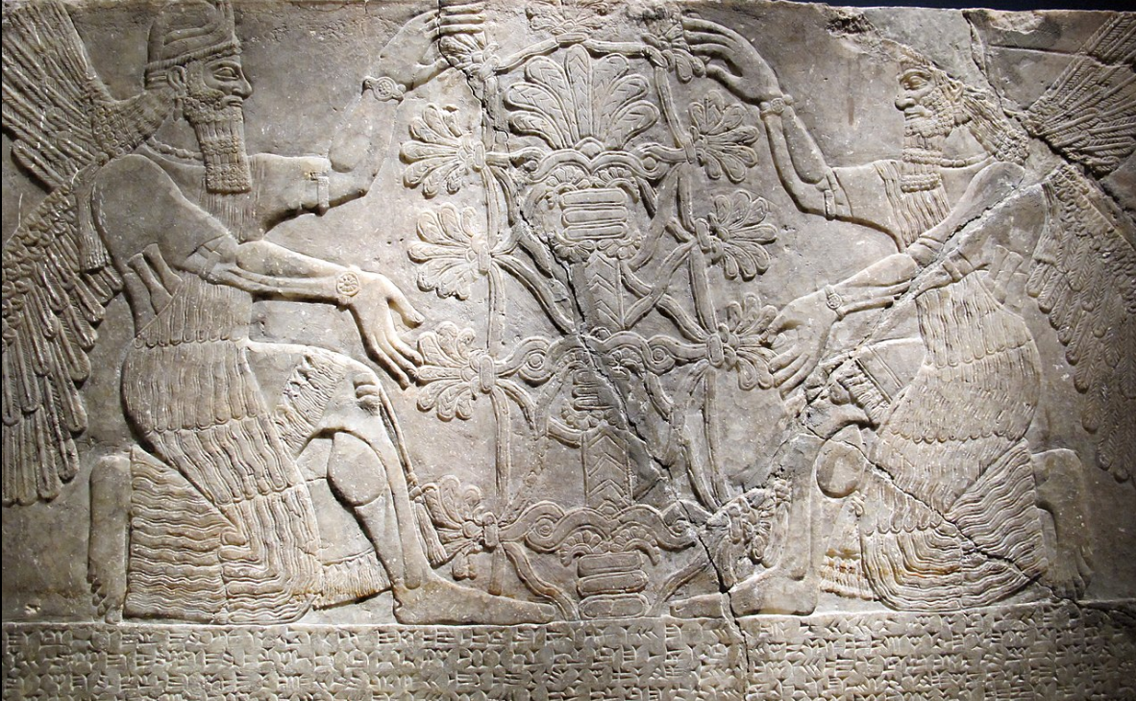
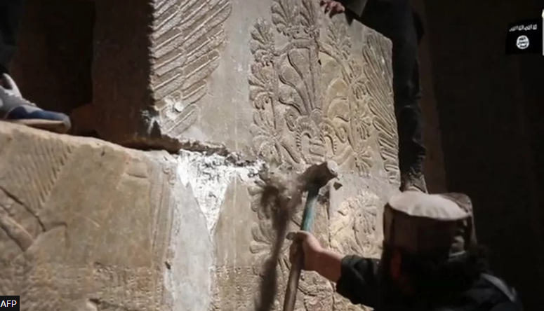
Ashurnarsipal II throws “biggest party ever” at Nimrud
~70,000 guests
Destroyed by Isis in 2015
“Tree of Life”

Slide 8
~1500 BC Hindu Vedas and Upanishads written down continues thru ~500 BC
Zhou dynasty relocates to east
Party at Nimrud
Battle of Qarqar – 1st Arab state – war camels
Assyria develops battering ram
Assyria - 1st known lock and key
Asia
Assyria – capital moves to Ninevah
Mesopotamia develops pottery glazing
Assyria develops steel weapons
Wrestling added to Olympics
1st Olympics
Greeks invent vowels
Europe
Iliad composed
Rome Founded
Africa
Carthage Founded
Earliest surviving sundial - Egypt
Americas
La Venta becomes Olmec Capital
Chávin de Huántar – first civilization in South America
900 BC
800 BC
700 BC

Slide 9
The “Gordian Knot” of Biblical Chronology
Until 1943, prevailing scholarly opinion was that 1&2 Kings and 2 Chronicles were based on oral history and not reliable for dates
Edwin Thiele published “The Mysterious Numbers of the Hebrew Kings” in 1943 and explained the chronology
Jewish year is a lunar year of 355 days
Archaeological records of Tyre established Solomon’s death in 931 BC
Israel and Judah used different methods of counting regnal years
Israel used a “Non-Accession” method and backdated regnal years to the previous spring
Judah used an “Accession” method and postdated regnal years to the next fall
Exception for ~50 years after Jehoram married daughter of Ahab
Relative dates are given in the opposite method
Several kings had co-regencies (e.g. David and Solomon)

Slide 10
1st & 2nd Kings
1st & 2nd Chronicles
Kingdom of Israel
Kingdom of Judah
(David’s Line)
Man’s Failings
God’s Faithfulness
Rebellion & Tragedy
Redemption
Politics and Power
Religious and Priestly

Slide 11
1 Kings 11:9-13
And the LORD was angry with Solomon, because his heart was turned from the LORD God of Israel, which had appeared unto him twice,
And had commanded him concerning this thing, that he should not go after other gods: but he kept not that which the LORD commanded.
Wherefore the LORD said unto Solomon, Forasmuch as this is done of thee, and thou hast not kept my covenant and my statutes, which I have commanded thee, I will surely rend the kingdom from thee, and will give it to thy servant.
Notwithstanding in thy days I will not do it for David thy father's sake: but I will rend it out of the hand of thy son.
Howbeit I will not rend away all the kingdom; but will give one tribe to thy son for David my servant's sake, and for Jerusalem's sake which I have chosen.

Slide 12
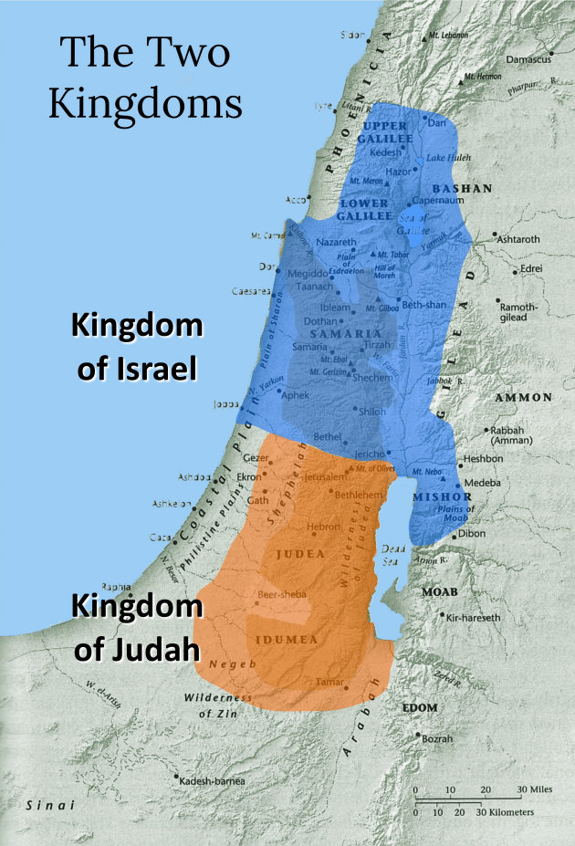

Slide 13
Isaiah 7:17, “The Lord will bring the king of Assyria upon you and your people and your father’s house – days that have not come since the day that Ephraim departed from Judah.”

Slide 14
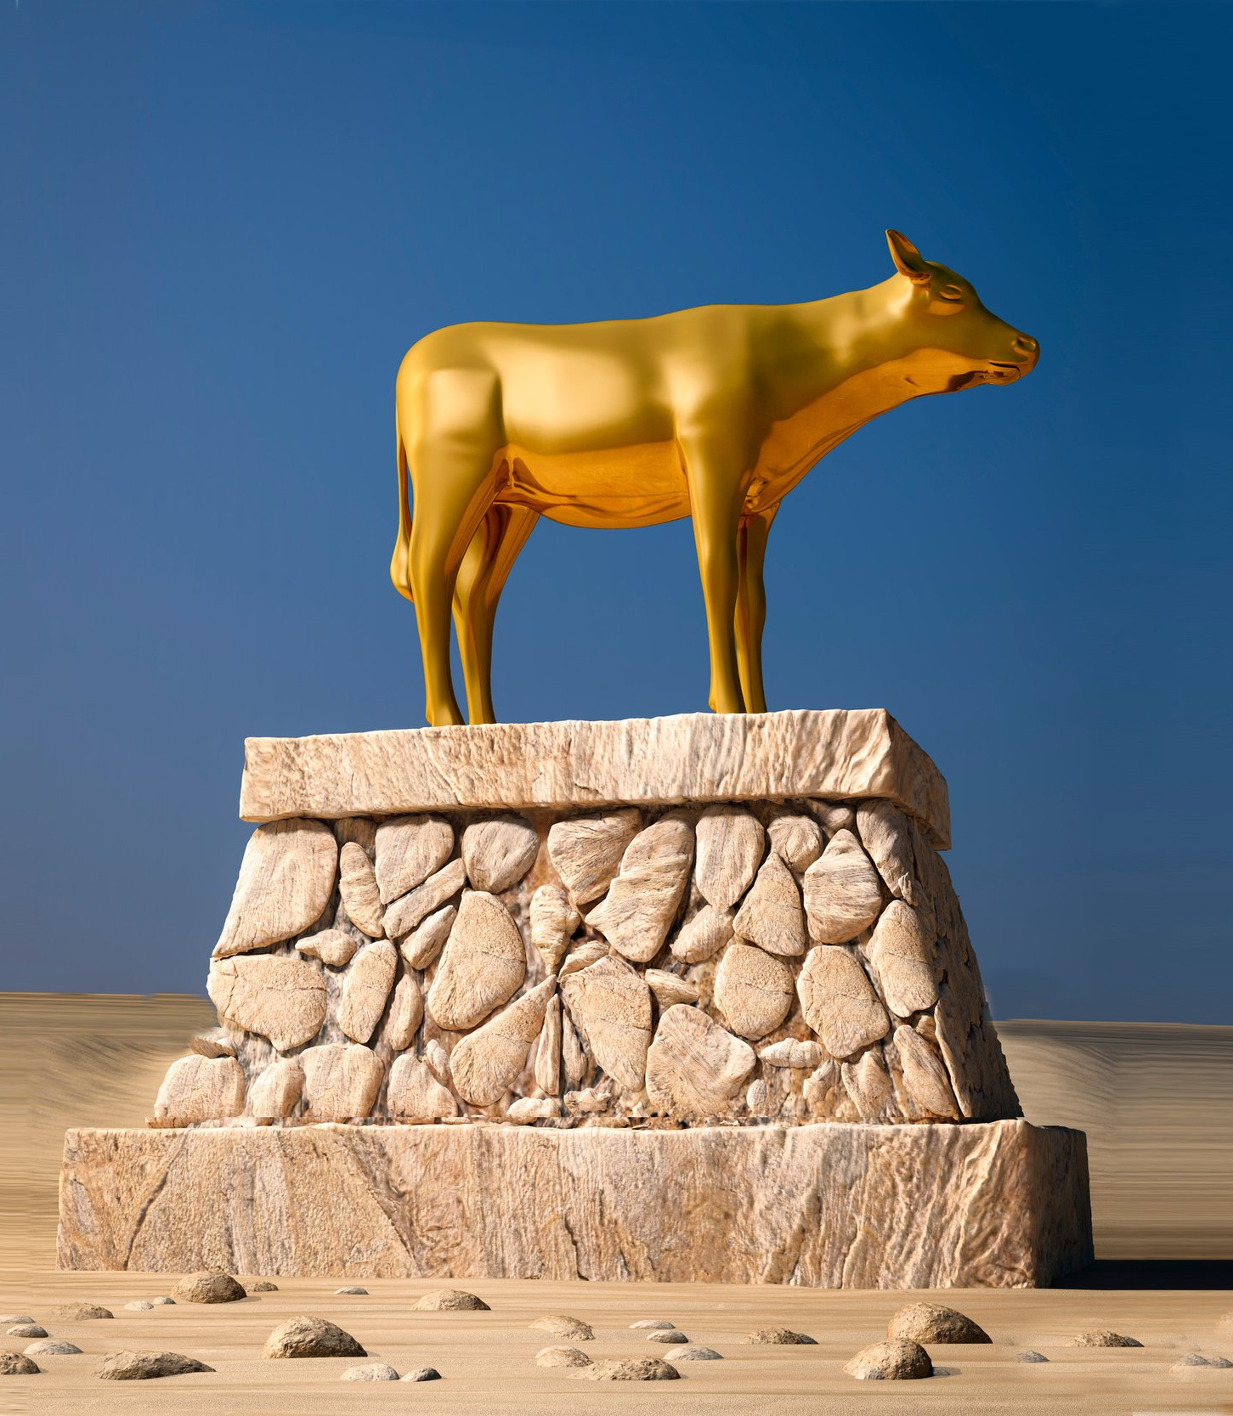
Sin of Jeroboam
Jeroboam created a false religion
A religion of convenience!
Don’t go to Jerusalem to worship! Stay close to home!
1 Kings 12:28, “Therefore the king asked advice, made two calves of gold, and said to the people, “it is too much to go up to Jerusalem. Here are your gods, O Israel! Which brought you up from the land of Egypt!”

Slide 16
Sins of Jeroboam
2 Chronicles 11:15 – “Then he appointed for himself priests for the high places, for the demons, and the calf idols which he had made.”
1 Kings 12:32-33 – “He sacrificed… he made offerings… he ordained feasts… he offered sacrifices… he burned incense”
He is causing Israel to sin!
Come to God in whatever way is convenient for you!
Keep worshipping the true God, but incorporate some cool things from the heathen nations!
Judges 17:6 – “everyone did what was right in his own eyes.”

Slide 17
Sins of Jeroboam (and all the Kings of Israel)
2 Kings 17:6-20 – “read the charges”
“Feared other god”
“Walked in the statues of the nations before them”
“secretly did things that were not right”
“built high places”
ALL THEIR CITIES
EVERY HIGH HILL
UNDER EVERY GREEN TREE
“set up sacred pillars”
“set up wooden images”
“burned incense”
“served idols”
“stiffened their necks”
“worshipped the host of heaven”
“rejected His statutes”
“passed their children through the fire”
“witchcraft & soothsaying”

Slide 18
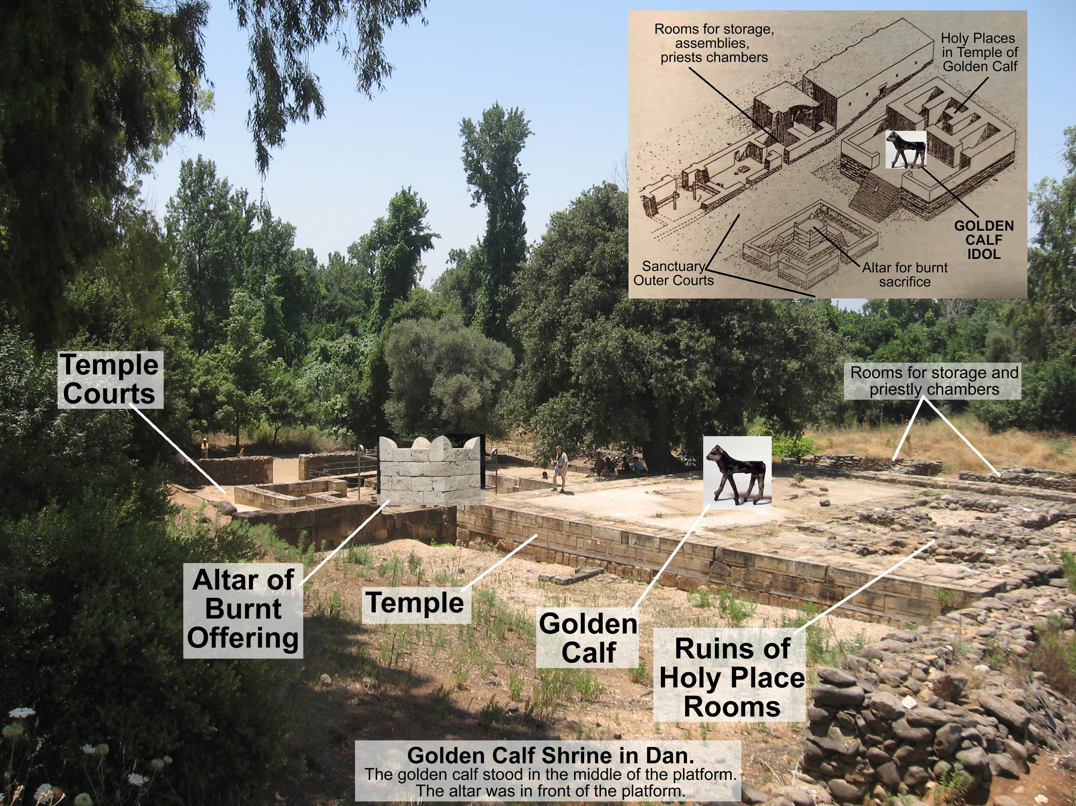

Slide 19
“Walked in all the sins of Jeroboam” “he did not depart from the sins of Jeroboam”
Nadab – 1 Kings 15:26, 28,
Baasha – 1 Kings 15:32, 16:2,7
Kimri – 1 Kings 16:19
Omri – 1 Kings 16:25
Ahab – 1 Kings 16:31
Ahaziah – 1 Kings 22:52
Jehoram – 2 Kings 3:3
Jehu – 2 Kings 10:29, 31
Jehoahaz – 2 Kings 13:2
Jehoash – 2 Kings 13:11
Jeroboam – 2 Kings 14:24
Zechariah – 2 Kings 15:9
Menahem – 2 Kings 15:18
Pekahiah – 2 Kings 15:24
Pekah – 2 Kings 15:28
19 times!

Slide 20
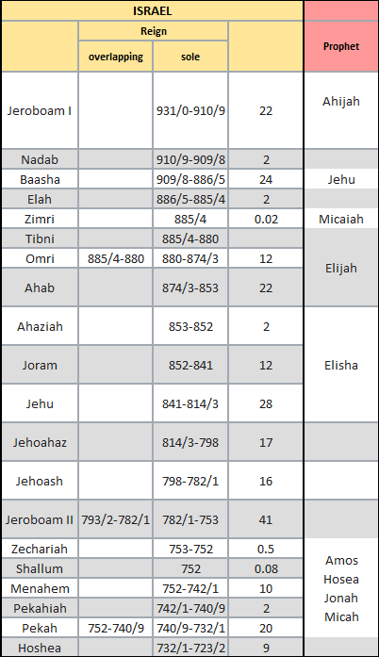

Slide 21
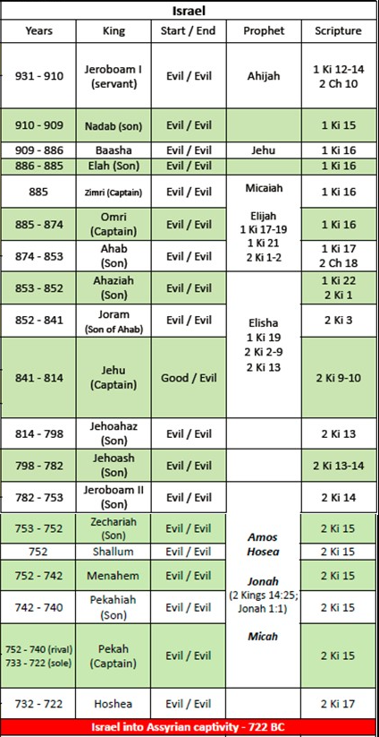
209 Years of Idolatry
9 Dynasties
Typo in image
should read
740-732 (sole)

Slide 22
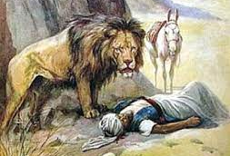
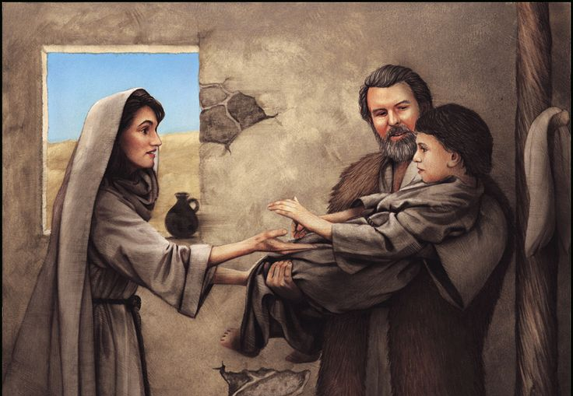
The Prophets
Ahijah
Jehu
Micaiah
Elijah
Elisha
Amos
Hosea
Micah

Slide 23
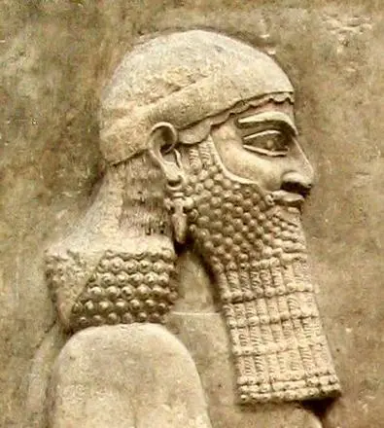
Israel falls – 722 B.C.
Shalmanesser – King of Assyria invades
Hoshea, the last King of Israel tried to go behind his back to support Egypt. Conflict lasts 6 YEARS!
Sargon II – King of Assyria takes the credit, Shalmanesser may have died before the 6 year campaign was over.

Slide 24
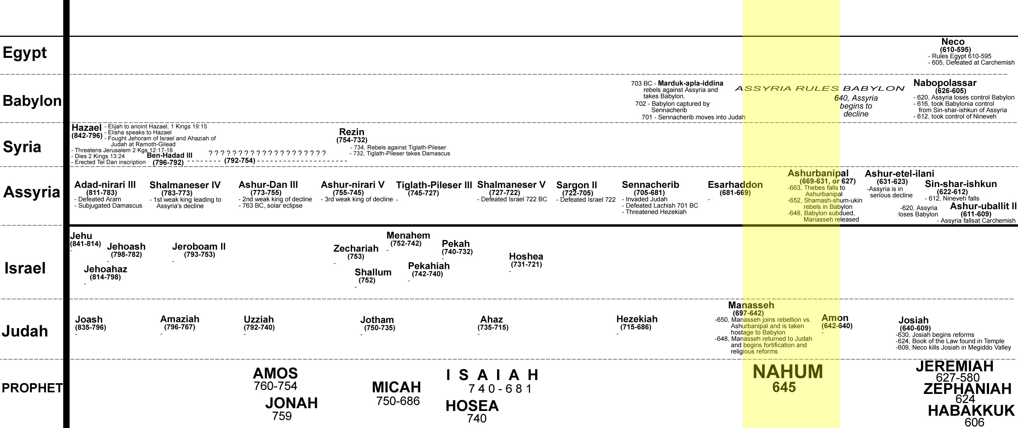

Slide 25
Finale of Israel
2 Kings 17:21
“And the LORD rejected all the descendants of Israel, afflicted them, and delivered them into the hand of plunderers, until He had cast them from His sight.”
2 Kings 17:22-23
“For the children of Israel walked in all the sins of Jeroboam which he did; they did not depart from them, until the LORD removed Israel out of His sight, as He said by all His servants the prophets. So Israel was carried away from their own land to Assyria, as it is to this day.”
Assyria fills the land with people from foreigners, who do not follow the true God.

Slide 26
Israel Timeline
Nadab
950
925
900
Solomon
Jereboam 1
Baasha
931
910
909
Ahijah
Prophet to Israel
Prophet to Both
Prophet to Other
or
Bad King
Good King
King starts good and ends bad

Slide 27
Israel Timeline
Zimri
Elah
Ahaziah
900
875
850
Baasha
Omri
Ahab
Joram
886
874
853
Jehu
Micaiah
Elijah
Prophet to Israel
Prophet to Both
Prophet to Other
or
Bad King
Good King
King starts good and ends bad

Slide 28
Israel Timeline
850
825
800
Jehu
Jehoahaz
841
814
853
Elisha
Prophet to Israel
Prophet to Both
Prophet to Other
or
Bad King
Good King
King starts good and ends bad

Slide 29
Israel Timeline
Shallum
800
775
Zechariah
750
Jehoash
Jereboam II
798
782
753
Elisha
Amos
Jonah
Prophet to Israel
Prophet to Both
Prophet to Other
or
Bad King
Good King
King starts good and ends bad

Slide 30
Israel Timeline
Assyria conquers Israel
(the 10 lost tribes)
Pekahiah
750
725
700
Menahem
Pekah
Hoshea
742
732
722
Elisha
Hosea
Isaiah
Micah
Prophet to Israel
Prophet to Both
Prophet to Other
or
Bad King
Good King
King starts good and ends bad

