Slide 1
OT Timeline - Week 6
Divided Kingdom – Judah
931 BC – 722 BC
1 Kings
2 Kings
2 Chronicles
Jonah
Amos
Hosea
Isaiah
Micah
Obadiah
Joel
Nahum
Habakkuk
Zephaniah
Jeremiah
Ezekiel

Slide 2
Prepare to handle conflict
2 Chronicles chap. 10-36
Wrong Way
Right Way
Go your own way
2 Chron. 11:14-15
Jeroboam
Forsake the Law of the LORD.
2 Chron. 12:1
Rehoboam & all Israel
Unfaithful to the LORD.
2 Chron. 12:2
Decide
Trust the LORD
Set your Heart to seek the LORD God
Forsake – Bad friends, anger, pride.
Discipline
Know & Obey God’s Law (Word)
Serve the LORD (Faithfully)
Desire
Pray & Confess (Consistently)
Follow godly examples (David)
Teach others (grow)

Slide 3
Prepare to handle conflict (our lives) 2 Chronicles chap. 10-36
Right Way
Decide
Trust the LORD for there is no besides Thee to help, so help us…for we trust in Thee (14:11) King Asa | Set your Heart to seek the LORD God (11:16) and those from all the tribes of Israel who set their hearts on seeking the LORD God of Israel
Forsake the priests…left pasture lands and property (11:14) friends, pride
Discipline
Know & Obey God’s Law (Word)
Serve the LORD (Faithfully) King Josiah (34:30-33)
Desire Ezra 7:10; 9:6
Pray & Confess (Consistently)
Follow godly examples.
Teach others (grow)

Slide 4
Kingdom of Israel
950
925
Nadab
900
Solomon
Jereboam 1
Baasha
931
910
909
Ahijah
Shemaiah
913
911
950
Rehoboam
Asa
925
900
Kingdom of Judah
Abijah
Prophet to Israel
Prophet to Both
Prophet to Other
or
Bad King
Good King
King starts good and ends bad

Slide 5
Kingdom of Israel
Joram
Zimri
850
900
Elah
875
Ahaziah
Baasha
Omri
Ahab
886
874
853
Jehu
Micaiah
Elijah
Daughter marries Jehoram, next king
Hanani
870
Asa
Jehoshaphat
900
875
850
Kingdom of Judah
Prophet to Israel
Prophet to Both
Prophet to Other
or
Bad King
Good King
King starts good and ends bad

Slide 6
Kingdom of Israel
850
825
Jehu
841
Elisha
Ahab’s Daughter marries Jehoram,
Obadiah
Joel
848
841
835
Jehoshaphat
Jehoram
Athaliah
Joash
850
825
Ahaziah
Kingdom of Judah
Prophet to Israel
Prophet to Both
Prophet to Other
or
Bad King
Good King
King starts good and ends bad

Slide 7
Kingdom of Israel
825
800
Jehu
Jehoahaz
814
Elisha
Joel
Joash
825
800
Kingdom of Judah
Prophet to Israel
Prophet to Both
Prophet to Other
or
Bad King
Good King
King starts good and ends bad

Slide 8
Kingdom of Israel
Shallum
750
800
775
Zechariah
Jehoash
Jereboam II
798
782
753
Elisha
Amos
Jonah
796
767
Joash
Amaziah
Uzziah
800
775
750
Kingdom of Judah
Also called Azariah
Prophet to Israel
Prophet to Both
Prophet to Other
or
Bad King
Good King
King starts good and ends bad

Slide 9
Israel Timeline
Pekahiah
Assyria conquers Israel
(the 10 lost tribes)
750
725
700
Menahem
Pekah
Hoshea
742
732
722
Elisha
Hosea
Isaiah
Micah
740
732
716
Uzziah
Jotham
Ahaz
Hezekiah
750
725
700
Kingdom of Judah
Prophet to Israel
Prophet to Both
Prophet to Other
or
Bad King
Good King
King starts good and ends bad

Slide 10
Isaiah
Micah
687
Hezekiah
Manasseh
700
675
650
Kingdom of Judah
Prophet to Israel
Prophet to Both
Prophet to Other
or
Bad King
Good King
King starts good and ends bad

Slide 11
Nahum
Habakkuk
Zephaniah
Jeremiah
Ezekiel
643
641
609
Manasseh
Josiah
Jehoiakim
650
625
Jehoahaz
600
Amon
Kingdom of Judah
Prophet to Israel
Prophet to Both
Prophet to Other
or
Bad King
Good King
King starts good and ends bad

Slide 12
Habakkuk
Zephaniah
Jeremiah
Babylon conquers Judah
70 years of captivity
Ezekiel
598
586
Jehoiakim
Zedekiah
600
Jehoiachin
575
550
Kingdom of Judah
Prophet to Israel
Prophet to Both
Prophet to Other
or
Bad King
Good King
King starts good and ends bad

Slide 13
~1500 BC Hindu Vedas and Upanishads written down continues thru ~500 BC
771 Zhou dynasty relocates to east
870 Party at Nimrud
853 Battle of Qarqar – 1st Arab state – war camels
850 Assyria develops battering ram
710 Assyria - 1st known lock and key
Asia
700 Assyria – capital moves to Ninevah
850 Mesopotamia develops pottery glazing
800 Assyria develops steel weapons
704 Wrestling added to Olympics
776 1st Olympics
700 Greeks invent vowels
Europe
750 Iliad composed
753 Rome Founded
Africa
814 Carthage Founded
800 Earliest surviving sundial - Egypt
Americas
900 La Venta becomes Olmec Capital
900 Chávin de Huántar – first civilization in South America
900 BC
800 BC
700 BC

Slide 14
~1500 BC Hindu Vedas and Upanishads written down continues thru ~500 BC
722 Assyria conquers Israel
650 Babylon – Epic of Gilgamesh written
710 Assyria - 1st known lock and key
Asia
700 Assyria – capital moves to Ninevah
689 Assyria – conquers Babylon
704 Wrestling added to Olympics
650 Oracle at Delphi begins
700 Greeks invent vowels
Europe
Iliad composed
688 Boxing added to Olympics
667 Byzantium founded
650 earliest known coins
700 Egypt develops demotic
(hirelogyphs “for the people”)
Africa
663 Egypt - Memphis and Thebes
conquered by Assyria
Americas
750 BC
650 BC
550 BC

Slide 15
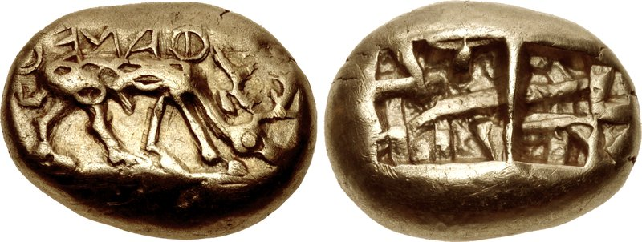
Earliest known coins - Ephesus
made of Electrum – a naturally occurring alloy of gold and silver

Slide 16
~1500 BC Hindu Vedas and Upanishads written down continues thru ~500 BC
722 Assyria conquers Israel
650 Babylon – Epic of Gilgamesh written
612 Battle of Charchemish
710 Assyria - 1st known lock and key
605 – Nebuchadnezzar begins rule
Asia
700 Assyria – capital moves to Ninevah
600 China – Poems of Shi Jing
689 Assyria – conquers Babylon
704 Wrestling added to Olympics
650 Oracle at Delphi begins
700 Greeks invent vowels
Europe
Iliad composed
688 Boxing added to Olympics
600 Dawn of Greek Theatre
667 Byzantium founded
600 Phoenecians sail around
Cape of Good Hope
650 earliest known coins
700 Egypt develops demotic
(hirelogyphs “for the people”)
Africa
663 Egypt - Memphis and Thebes
conquered by Assyria
600 Olmec statue – the Wrestler
Americas
750 BC
650 BC
550 BC

Slide 17
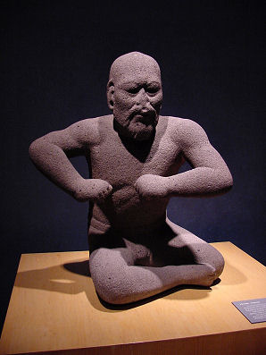
Olmec Statue – “The Wrestler”
Carved from Basalt – unusual material
24 inches high
Facial detail similar to Olmec “big heads”
Discovered in 1933

Slide 18
~1500 BC Hindu Vedas and Upanishads written down continues thru ~500 BC
722 Assyria conquers Israel
650 Babylon – Epic of Gilgamesh written
612 Battle of Charchemish
710 Assyria - 1st known lock and key
605 – Nebuchadnezzar begins rule
Asia
700 Assyria – capital moves to Ninevah
600 China – Poems of Shi Jing
689 Assyria – conquers Babylon
586 Babylon conquers Judah
704 Wrestling added to Olympics
650 Oracle at Delphi begins
594 Dawn of Greek Democracy
700 Greeks invent vowels
Europe
Iliad composed
688 Boxing added to Olympics
600 Dawn of Greek Theatre
667 Byzantium founded
600 Phoenecians sail around
Cape of Good Hope
650 earliest known coins
700 Egypt develops demotic
(hirelogyphs “for the people”)
Africa
663 Egypt - Memphis and Thebes
conquered by Assyria
600 Olmec statue – the Wrestler
Americas
750 BC
650 BC
550 BC

